Slide 1
How many of Colorado’s DUIs are DUIDs?
CTFDID
November, 2014
Notes:
Thank you.
Many have wondered how may of Colorado’s DUIs are actually DUIDs

Slide 2
Myths
Colorado’s DUID problem is all about marijuana
A 5 ng/ml THC limit is effective in reducing DUID
90% of DUIDs result in DUI convictions
None of the above are true.
Notes:
We’re going to address that question today, and along the way,
We’ll explode some popular myths
read
None of these are true

Slide 3
What you’re going to hear
Review of what’s known
New data – 2012 vehicular homicides/assaults
MJ-impaired driving is a problem
But not THE problem
MJ alone rarely caused highway death or injuries
Current laws can’t deal with DUID effectively
Proposed legislative initiatives
Notes:
Some of what you’ll hear this morning may be known to you, but bear with me – it’s important to understand the limitations of what you have heard.
New data -

Slide 4
How many of Colorado’s ~25,000 DUIs are due to drugs?
5%?
10%?
More?

Slide 5
We don’t know!
42-4-1301
42-4-1301 (1) (a)
“It is a misdemeanor for any person who is under the influence of alcohol or one or more drugs, or a combination of both alcohol and one or more drugs, to drive a motor vehicle or vehicle.”
STATES THAT SEPARATE ALCOHOL AND DRUG DUI STATUTE NUMBERS:
Pennsylvania
75-3802 (a)-(c) for alcohol (.08. .10 and .16 BAC respectively)
75-3802 (d) for drugs
California VC 23152 - effective Jan 1, 2014
(a) alcohol
(b) alcohol per se .08 BAC
(c) addicts
(d) commercial vehicle alcohol limit .04
(e) drugs
(f) combined alcohol and drugs
Hawaii 291E-61
alcohol
drugs
DUI alcohol per se
Notes:
The answer is that we don’t know!
We don’t know, because we don’t measure it.
Many have claimed that marijuana legalization in Colorado is an experiment. It’s not. In an experiment, one must measure the outcomes. We don’t measure DUID in Colorado.
We have a single statue number for DUI regardless of the cause – alcohol or drugs.
Compare that with states that have separate DUI alcohol and DUI drug statute numbers
These enable the states to track DUI alcohol and DUI drugs separately, to understand the nature of their DUI problem

Slide 6
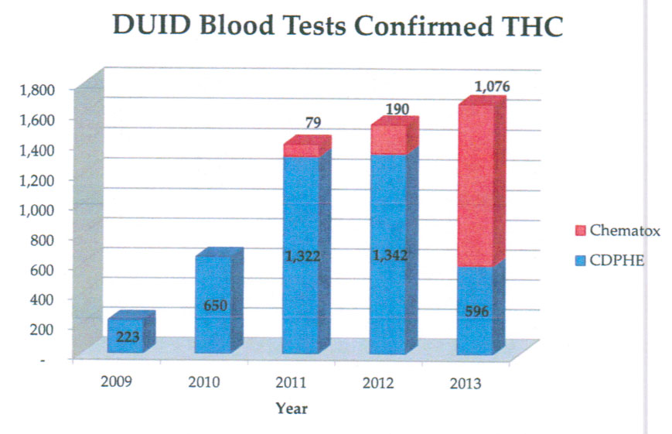
Laboratory reports
Notes:
We do have reports from the two labs active in 2012 – Chematox and CDPHE.
This shows some of their data, available on request, of samples tested that were positive for Delta 9 THC
Spike in 2010 - Ogden memo, no fed enforcement, dispensaries
This summary understates the problem for two reasons:
Most DUIDs are combined with alcohol. If alcohol is found, there is little incentive to test for drugs and many jurisdictions choose to not do so.
We’ve learned that only 2/3 of the suspected DUID drivers are tested for drugs

Slide 7
CSP Marijuana Citations
May-Oct 2013 pilot
283 DUI-MJ citations
55% < 5 ng/ml permissible limit
June YTD 2014
12.4% of DUIs are DUI MJ+
349 through June (~3,500/yr for entire state?)
Notes:
Recognizing problem w/ lack of DUID measures, CSP pilot 2013
Majority below permissible limit of 5 ng - come back to that
2014 continued the exercise, slightly modified
May infer 3500 DUI MJ for the state this year.
Unk # of CSP Arides – not tracked, so may be underreported
Separate database not linked with judicial outcomes, laboratory data, or other data bases, so its probative value is somewhat limited

Slide 8
Lakewood PD
2013
23% of DUI citations were suspected DUIDs
71% of tested DUID suspects were positive
2014
23% of DUI citations were suspected DUIDs
74% of tested DUID suspects were positive
40/70 THC, 79% of those tested were polydrug
22 benzodiazepines, 94% polydrug
Opioids, amphetamines, cocaine, 89% polydrug
Notes:
Other jurisdictions have taken it upon themselves to try to understand DUID. This is a summary of results from Lakewood PD
Like the CSP ad hoc data collection process, this isn’t connected with other data bases such as State Judicial

Slide 9
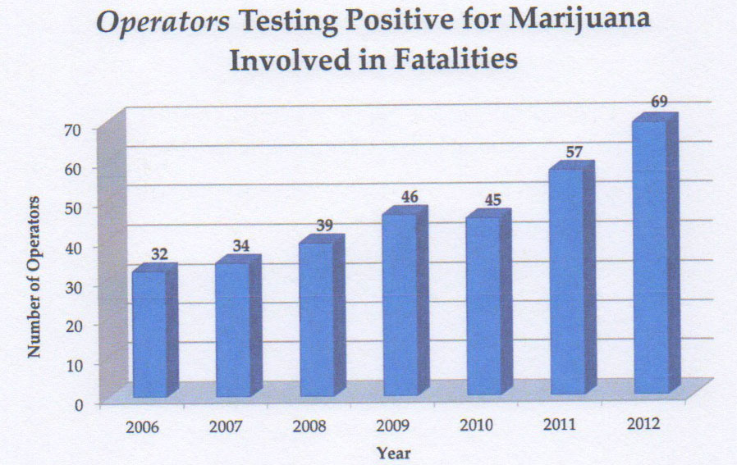
Notes:
You’ve likely seen charts like this from the FARS program – Fatality Analysis Reporting System
Coroners not required to report data to CDOT – 2012 was the first year with 100% reporting, thanks to RMHIDTA
Measures drug presence, not impairment, Most data is from coroners – subjects not charged w/ culpability
NHTSA’s ccding rules ensure that many polydrug users on marijuana will not be shown as having MJ in their blood, and we are now learning how prevalent polydrug abuse is
THC and carboxy THC treated alike, so results are irrelevant
NHTSA Traffic Safety Facts Nov ‘14 recognizes the first three of these problems – FARS is not useful to infer DUID,

Slide 10
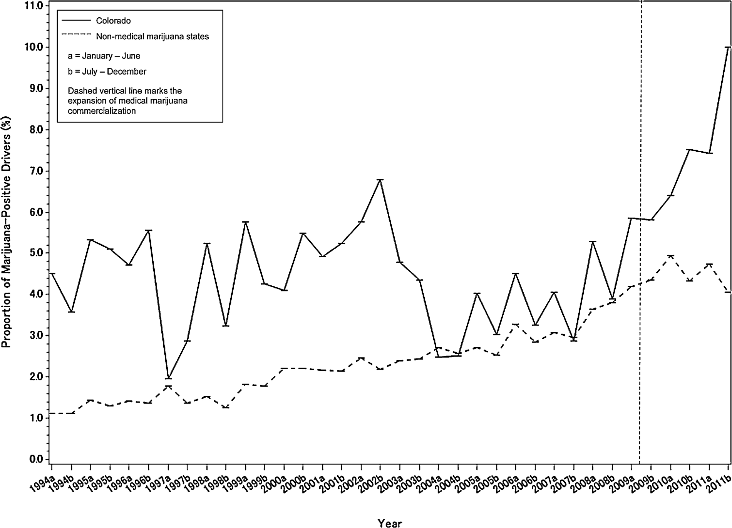
Prevalence of DUID Marijuana FARS
Trends in fatal motor vehicle crashes before and after marijuana commercialization in Colorado, Salomonsen-Sautel, et.al., Drug and Alcohol Dependence 140 (2014) 137-144
Notes:
No surprise, FARS data indicates we may have a DUI MJ problem – Stacy Sautel
Study 1994 thru 2011,
Coroners not required to report data to CDOT
Measures drug presence, not impairment
THC and carboxy THC treated alike, so results are irrelevant
Most data is from coroners – subjects not charged w/ culpability
NHTSA Traffic Safety Facts Nov ‘14 – FARS is not useful to infer DUID

Slide 11
DUID Victim Voices 2012 Study Structure
All VH and VA in 2012 n=246
Subset of above charged with DUI n=207
Determine cause of DUI charges (A, D, A+D)
Review court records
Affidavit of probable cause
Motions, letters, plea bargain agreements
Lab confirmation of blood tests, if available
First statewide estimate of % DUID in DUI
Notes:
I performed study to deal w/ shortcomings in FARS study and lack of otherwise comprehensive data
Data included defendant age and gender, crash details
Time of dispatch, blood draw, warrant, plea bargain

Slide 12
DUID Victim Voices 2012 Study Limitations
Only a subset of VA cases studied
100% (29) of VH
21% (37) of VA – (those that were pled down)
Court records are incomplete
Interviews reclassified 2 DUI-A cases as DUI – D
Youthful offender records are sealed
Lab results available on only 2/3 of cases
Drug screens are not standardized
Lab tests reclassified 2 DUI A cases as DUI A+D
Sampling delays make lab tests moot
Notes:
Caveats to the estimates that follow
If VH/VA results extrapolated to all DUIs, MJ impaired driving ~ double CSP/Lab estimates
Couldn’t rely on lab tests – only 2/3
Sampling delays – more later

Slide 13
DUID Victim Voices 2012 Study Key Finding #1 – DUI prevalence in VH/VA citations
83% of VH/VA defendants had DUI charges
 | DUI charge | Reckless Driving | Total
VH | 29 | 6 | 35
VA only | 178 | 37 | 211
Total | 207 (83%) | 43 (17%) | 246
Notes:
Must have prob cause for lab test – not VH or VA
Est prob cause takes time, legal challenges> dismissal
At least 83% VH/VA had prob cause for lab test – DUI
VH and VA results are similar
Remember this number – it will be important is supporting a proposed legislative initiative.

Slide 14
DUID Victim Voices 2012 Study Key Finding #2 – DUID prevalence in DUI citations
39% of DUIs involved drugs
Most were combined with alcohol
 | VA DUI n % | VH DUI n % | Total n %
Alcohol | 25 (68%) | 15 (52%) | 40 61%)
Drugs | 5 (14%) | 5 (17%) | 10 (15%)
Alcohol+Drugs | 7 (19%) | 9 (31%) | 16 (24%)
Total | 37 | 29 | 66
Notes:
Focus on 10+16=26
39% much higher than CSP estimate of 12.4% MJ only
Although 24% were alcohol and drugs combined, many had –OH below legal limits

Slide 15
DUID Victim Voices 2012 Study Key Finding #3 – Polydrug use
85% of DUID cases involved polydrug use
Drug class | Citations | % of DUIDs | % of DUIs
Polydrug or alcohol + drug | 22 | 85 | 33
Marijuana | 18 | 69 | 27
Opiates/opioids | 6 | 23 | 9
Amphetamines | 5 | 19 | 8
Cocaine | 4 | 15 | 6
Others (antidepressants, sedatives, benzodiazepines) | 6 | 23 | 9
Notes:
85% multiple drugs or drugs+ alcohol
Similar to L’w’d results, except L’w’d showed a much higher prevalence of benzodiazepines, and lower amphetamines
16 drugs+alcohol, 6 multiple drugs, 10 drugs+ -OH
18 MJ, all but 2 were polydrug
This is not to say there were only two cases of DUI- marijuana in the state, but only two cases in the tranche of 66 cases studied here.
Focusing efforts only on DUI MJ ignores the larger problem of DUID
Colorado’s data supports 2014 research published by Bogstrand in Forensic Science International that marijuana impairs driving only modestly, but it synergistically compounds the impairing effect of other substances. THC OR ~ 2.8 but >20 in combination w/ others. It’s better to focus on drug impairment than to focus on marijuana impairment, and especially o emphasize polydrug impairment.

Slide 16
DUID Victim Voices 2012 Study Key Finding #4 – Delays
Blood draw delays can make lab tests moot
49/66 cases recorded times: dispatch to draw
None required warrants
Mean 2.32 (1.31) hrs, range 0.83 – 8 hrs
VH>VA 2.66 vs 2.01 n.s.
CSP>Local 2.90 vs 1.91 p=.008
cf: Chematox 1.2 hrs for general DUI suspects
Notes:
2.32 mean not representative f(8 & 4 hr)
CSP rural

Slide 17
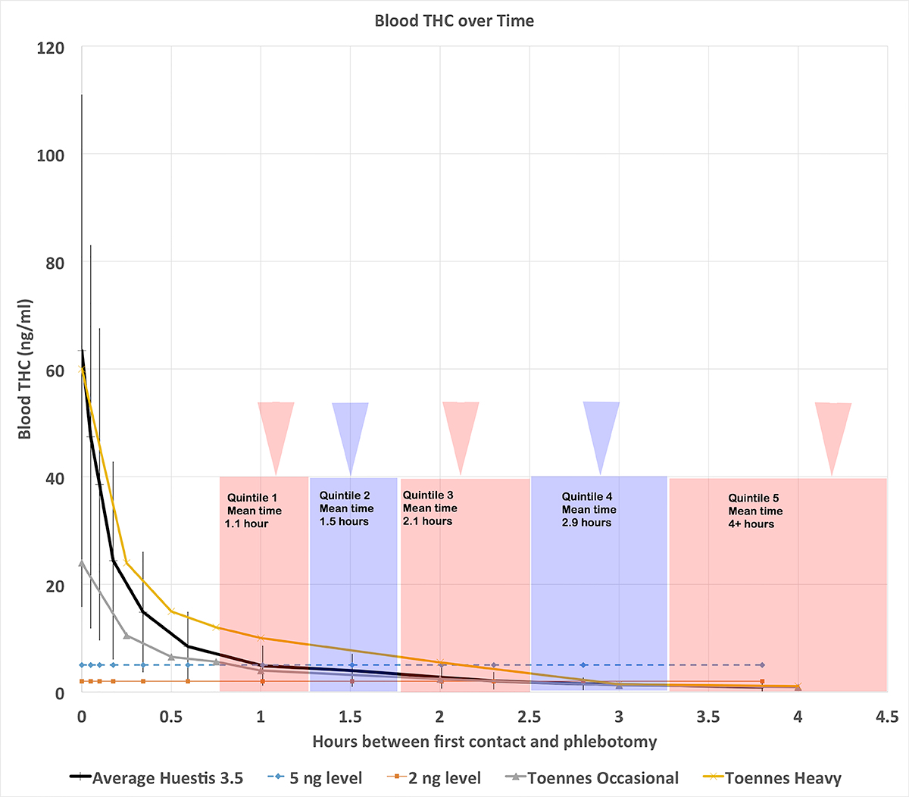
Notes:
Complex chart – compelling demonstrates that even if a driver were smoking a joint at the time of a crash, blood testing would likely find that driver innocent of DUID under Colorado law.
THC blood content as a function of time since cessation of smoking – from zero to 4½ hours
Three decay curves from two authors, using occasional smokers, heavy smokers, and combined smokers. The decay is from both THC metabolism and THC redistribution to the body’s fat stores.
The wide error bars indicate the widely varying results that can be expected, even in these well controlled studies. Immediately after smoking, THC content may vary from 20 to 120 ng/ml
But regardless of the starting level, it drops by 90% in the first hour after smoking. This chart does not apply to marijuana edibles that have a different metabolic/distribution curve, it only applies to smoked marijuana.
Dashed blue line shows the 5 ng THC limit in Colorado, the orange line shows the 2 ng limit in NV and OH
Overlaid delay times in quintiles. The left-most pink box shows the speediest 20% of cases with an average delay time of 1.1 hours before blood collection
The next blue box shows the next speediest 20% of cases with a an average delay time of 1½ hrs before blood collection, and so forth.
If smoking during crash – on average, blood testing is likely to find the defendant will test below 5 ng/ml – unless they are a heavy user of marijuana.
If the defendant is lucky enough to be tested in the fourth or fifth quintile of delays, even a heavy user is likely to show no THC at all in their blood. Even if they had been smoking at the time of a crash
Obviously, these results would be even worse if smoke 1-2 hr before crash & impaired

Slide 18
Labs confirm delay dilemma
Lab | Year(s) | Cannabis + | THC+ | THC≥5ng | % Cannabis+ <5ng
CDPHE | 2010-13 | 6,595 | 3,910 | 1,998 | 70%
Chematox | 2013 | 2,159 | 1,561 | 1,252 | 42%
Notes:
NMS reports 70% <5 ng in >10,000 study

Slide 19
The 90% DUI Conviction Myth
The ability to analyze judicial outcome is an essential part of any data base used to study DUID
Defendant Class | DUI Conviction | DUI/DWAI Conviction | Data base | n
All DUIs | 73% | 82% | 1st half 2010, 18/64 counties | 11,221
DUIDs | 40% | 50% | 2012 DVV study | 10
DUID – MJ | 0% | 50% | 2012 DVV study | 2
DUID results suggest a conviction problem may exist, but the sample size is too low to be convincing.
Notes:
The following demonstrates why the ability to analyze judicial outcomes is an essential part of any data base used to study DUID, both to ensure deterrences to DUID are adequate, and to ensure justice for victims.
We’ve all heard the claim that there is no need for drugged driving per se laws, since 90% of DUI charges already result in convictions. But convictions don’t necessarily mean DUI convictions. A conviction for a broken tail light is less meaningful than a DUI conviction. More importantly, no one, until now, has been able to quantify the DUID conviction rate separately from DUI alcohol.
We did a study of 11,221 DUI cases in 2010. We found --- Numbers would be higher if deferred judgments were included.
In our 2012 study we’re able to look separately at DUID convictions and here’s what we found.
These numbers suggest we may have a greater problem convicting drugged drivers than drunk drivers, but unfortunately the numbers are too small to be very convincing.
So let’s dig deeper into this, especially the DUI Marijuana cases

Slide 20
Example MJ cases None convicted of DUI
Marijuana alone
Arapahoe County – VA DUI charged
Hit & run, delayed test
Priors: DUI, VA, weapons, possession
VA Reckless, 2 years probation
Boulder County – VA DUI charged
Smoking a blunt while driving
VA Reckless, DWAI, probation
Marijuana + <.05 BAC alcohol
Boulder County – VA DUI charged
.044 BAC + 3 ng THC
VA Reckless, probation
Routt County – VH DUI charged
.046 BAC + 8 ng THC
Careless driving resulting in death, 1 year
Notes:
Let’s look more closely at DUI Marijuana convictions and I will highlight four cases, 3 VA, 1 VH, 2 MJ alone, 2 MJ with alcohol below the .05 safe limit

Slide 21
DUID Victim Voices 2013 Study
Data collection in progress
100% VH & 100% VA
April 19, 2013 State vs. McNeeley
Study will explore judicial outcomes
Why isn’t this done by the state?

Slide 22
Legislative recommendations
First, get the data!
Separate DUI-A from DUID (Model PA, HI and CA)
Require coroners to report to CDOT (Amend 42-4-1301.1)
Fund DUID data collection and analysis
Then, act on the data we now have
More DREs and ARIDEs
Make death or SBI a probable cause for testing
(Model AZ, FL, HI, ME, MN, NV, NY, SC)
Eventually, based on the data, consider:
Stop presumption of innocence for <.05 BAC
Statewide use of electronic warrants to reduce sample delays
Change 5 ng/ml THC permissible limit to 1-2 ng/ml
Enable use of oral fluid roadside testing for deterrence and “PBT”
Zero tolerance for illegal scheduled drugs in impaired drivers (~NZ)
Notes:
Death or SBI is probable cause for testing:
Reduce delays caused by establishing & documenting separate probable cause
Eliminate challenges that can make lab tests inadmissible
Steve & Patty Smith – Weld County
Landra Fabrizius

Slide 23
Thank you! What you heard
MJ DUI is a problem, but not THE problem
DUID is large proportion of our DUIs
We don’t measure/manage DUIDs
We can and should improve DUID laws

