Slide 1
ITFDD
Criminal Justice System
Impairment concepts
Impairment vs Blood levels
Blood testing process
Alternatives to blood testing

Slide 2
Impairment concepts
Legal determination of impairment/ influence
  ≥.08 BAC DUI per se
  ≥ .05 BAC DWAI, perhaps DUI
  ≥ 5 ng Δ⁹THC perhaps DUI
Scientific assays of impairment
  Psychomotor skills
  Neurocognitive ability
  Executive function

Slide 3
Types of Impairment
Psychomotor Skills –
  Reaction time, tracking,
    Necessary for routine driving
Neurocognitive Ability –
  Thinking, judging, reasoning,
    Necessary for routine driving
Executive Function –
  Provides sustained vigilance, ability to use all information to respond appropriately.
    Divided Attention Tasks
    Critical when driving demands are more complex

Slide 4
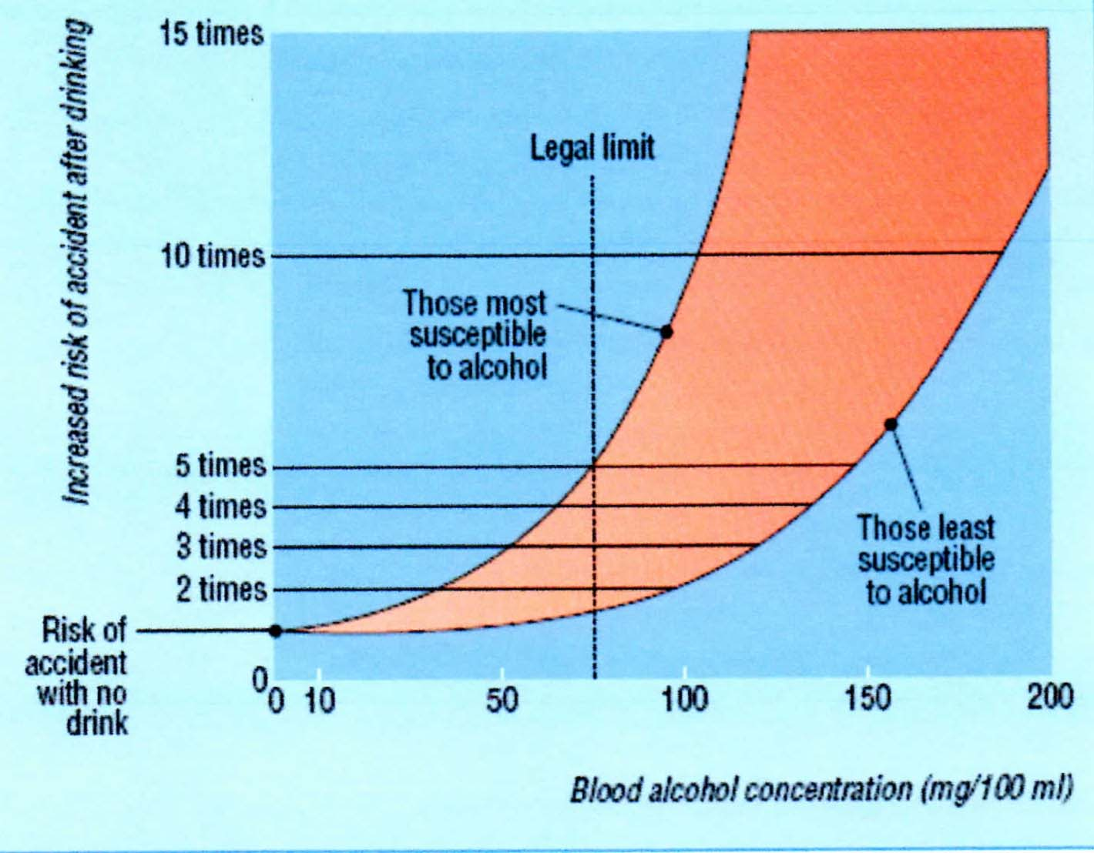
Impairment vs drug levels
Blood is not impaired. The brain is impaired
+ Blood test is an impairment indicator, not proof
Sensitivity
  Alcohol ≈ 2x
  Cannabis ≈ 10 x
  Opioids ≈ 100 x

Slide 5
Drug “tolerance”
Chronic users develop tolerance to some effects
Marijuana
  Psychomotor skills – chronic users may compensate
  Neurocognitive ability – chronic users can develop tolerance
  Executive function – all users are affected

Slide 6
Blood testing
Screening
  Immunofluorescence
  Qualitative identification of presence of drug class
    e.g. cannabinoids
Confirmation
  GC/MS or LC-MS/MS
  Quantitative report by specific drug
    Limits of quantitation

Slide 7
Blood sampling process
Observe problematic driving behavior
Stop
Establish probable cause (SFST, DRE, other)
  Note: impaired chronic THC users may pass SFSTs
Request permission for blood draw
Transport defendant to phlebotomy site
Draw blood
Typical time before blood is drawn
  45 minutes for routine stop
  3-4 hours in case of death or serious injury

Slide 8
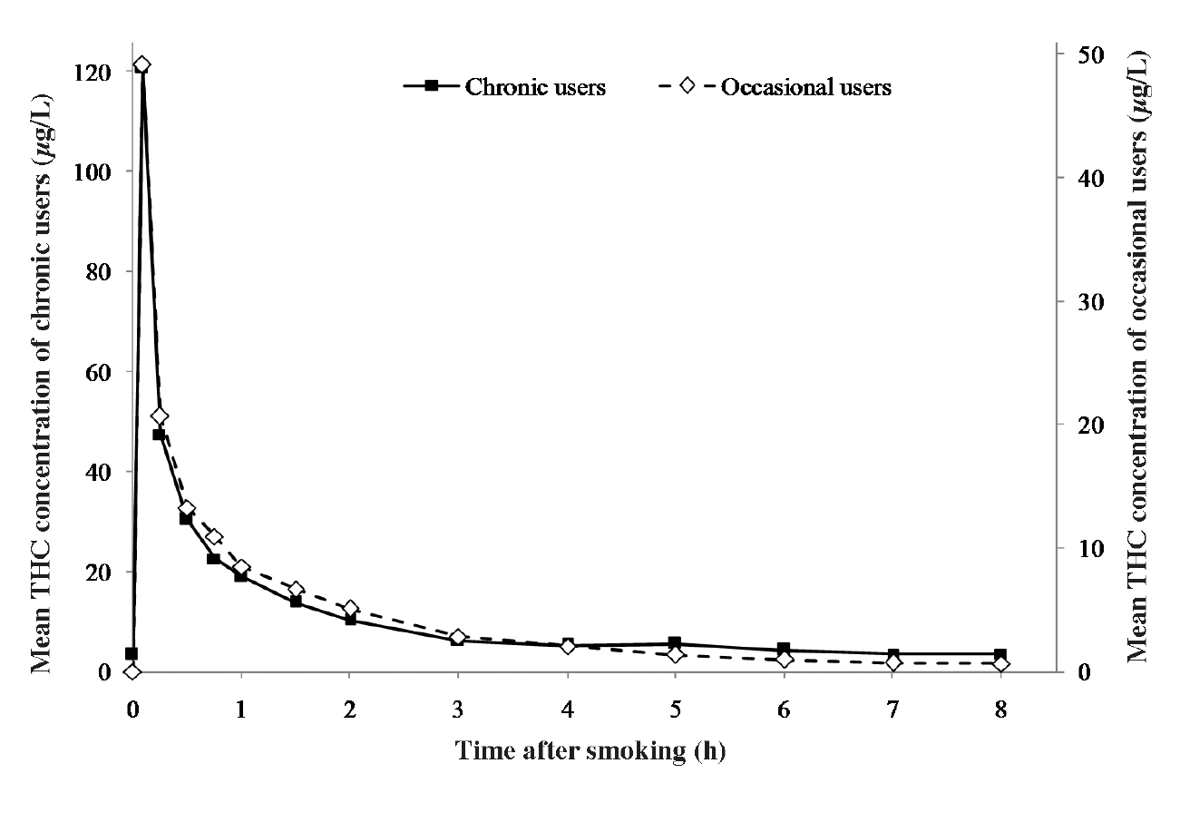
Chronic vs Occasional MJ Users
J of Analytical Toxicology, 2008;V32:470-477: Comparison of Cannabinoid Pharmacokinetic Properties in Occasional and Heavy Users Smoking a Marijuana or Placebo Joint; Stefan W. Toennes, Johannes G. Ramaekers, Eef L Theuissen, Manfred R. Moeller, Gerold F. Kauert

Slide 9
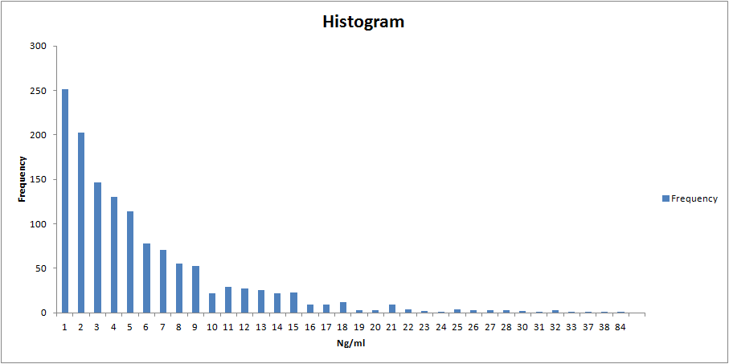
CDPHE - 2012
72% of cannabinoid positive defendants test below 5 ng
2,099 cannabinoid confirmation tests
1,326 were ≥1 ng THC (above limit of quantitation)
595 were ≥5 ng THC. That’s only 28% of cannabinoid positive defendants

Slide 10
Blood Testing Alternatives
Hair – historical use only
Urine – recent historical use only
Saliva – Promising, but not validated
  Issues
    Sensitivity, accuracy, repeatability, contamination
    Brain-Blood-Saliva correlation
  Examples:
    Draeger DDT 5000
    Securetec Drugwipe
    Brannan Oratect
Breath – Potential, but in very early stages
    SensAbues

