Slide 1

DUID
Driving Under the Influence of Drugs
Pueblo West HS
Feb 2018
Notes:
I’m about to spray you with a firehose of data about drug-impaired driving. But I don’t expect you to remember the data, much of which will become out of date within a few years. What I want you to do is to understand the following messages:
1 Drugged driving is a serious, under-recognized, misunderstood problem, and it’s not just about marijuana.
2 Much of what you hear from the marijuana lobby, the media, politicians, is either wrong or misleading. Today you will begin to learn how to know when you are being lied to.
3 Colorado has the weakest drugged driving laws in the nation You will learn how we plan to fix that.
You can get copies of this presentation if you like, so you don’t have to take notes, but you might want to jot down questions to ask at the end of this. So let’s begin.

Slide 2

Notes:
My son Brian was the lead video game designer for Company of Heroes, produced by Relic Entertainment. In 2010, he and his wife Erin celebrated their 5th wedding anniversary. They were looking forward to their first baby, and being traditionalists, they chose to not learn the gender of the baby until the day of birth.
September 3rd of that year, they drove to a vacation home owned by Erin’s parents on Whidbey Island in Washington. They were going to spend a weekend with some good friends from British Columbia. Brian saw an out-of-control SUV headed his way, so he braked and he swerved to avoid a collision, while trying to avoid shooting over the embankment at the edge of the road. In so doing, he placed himself between the SUV and Erin.

Slide 3
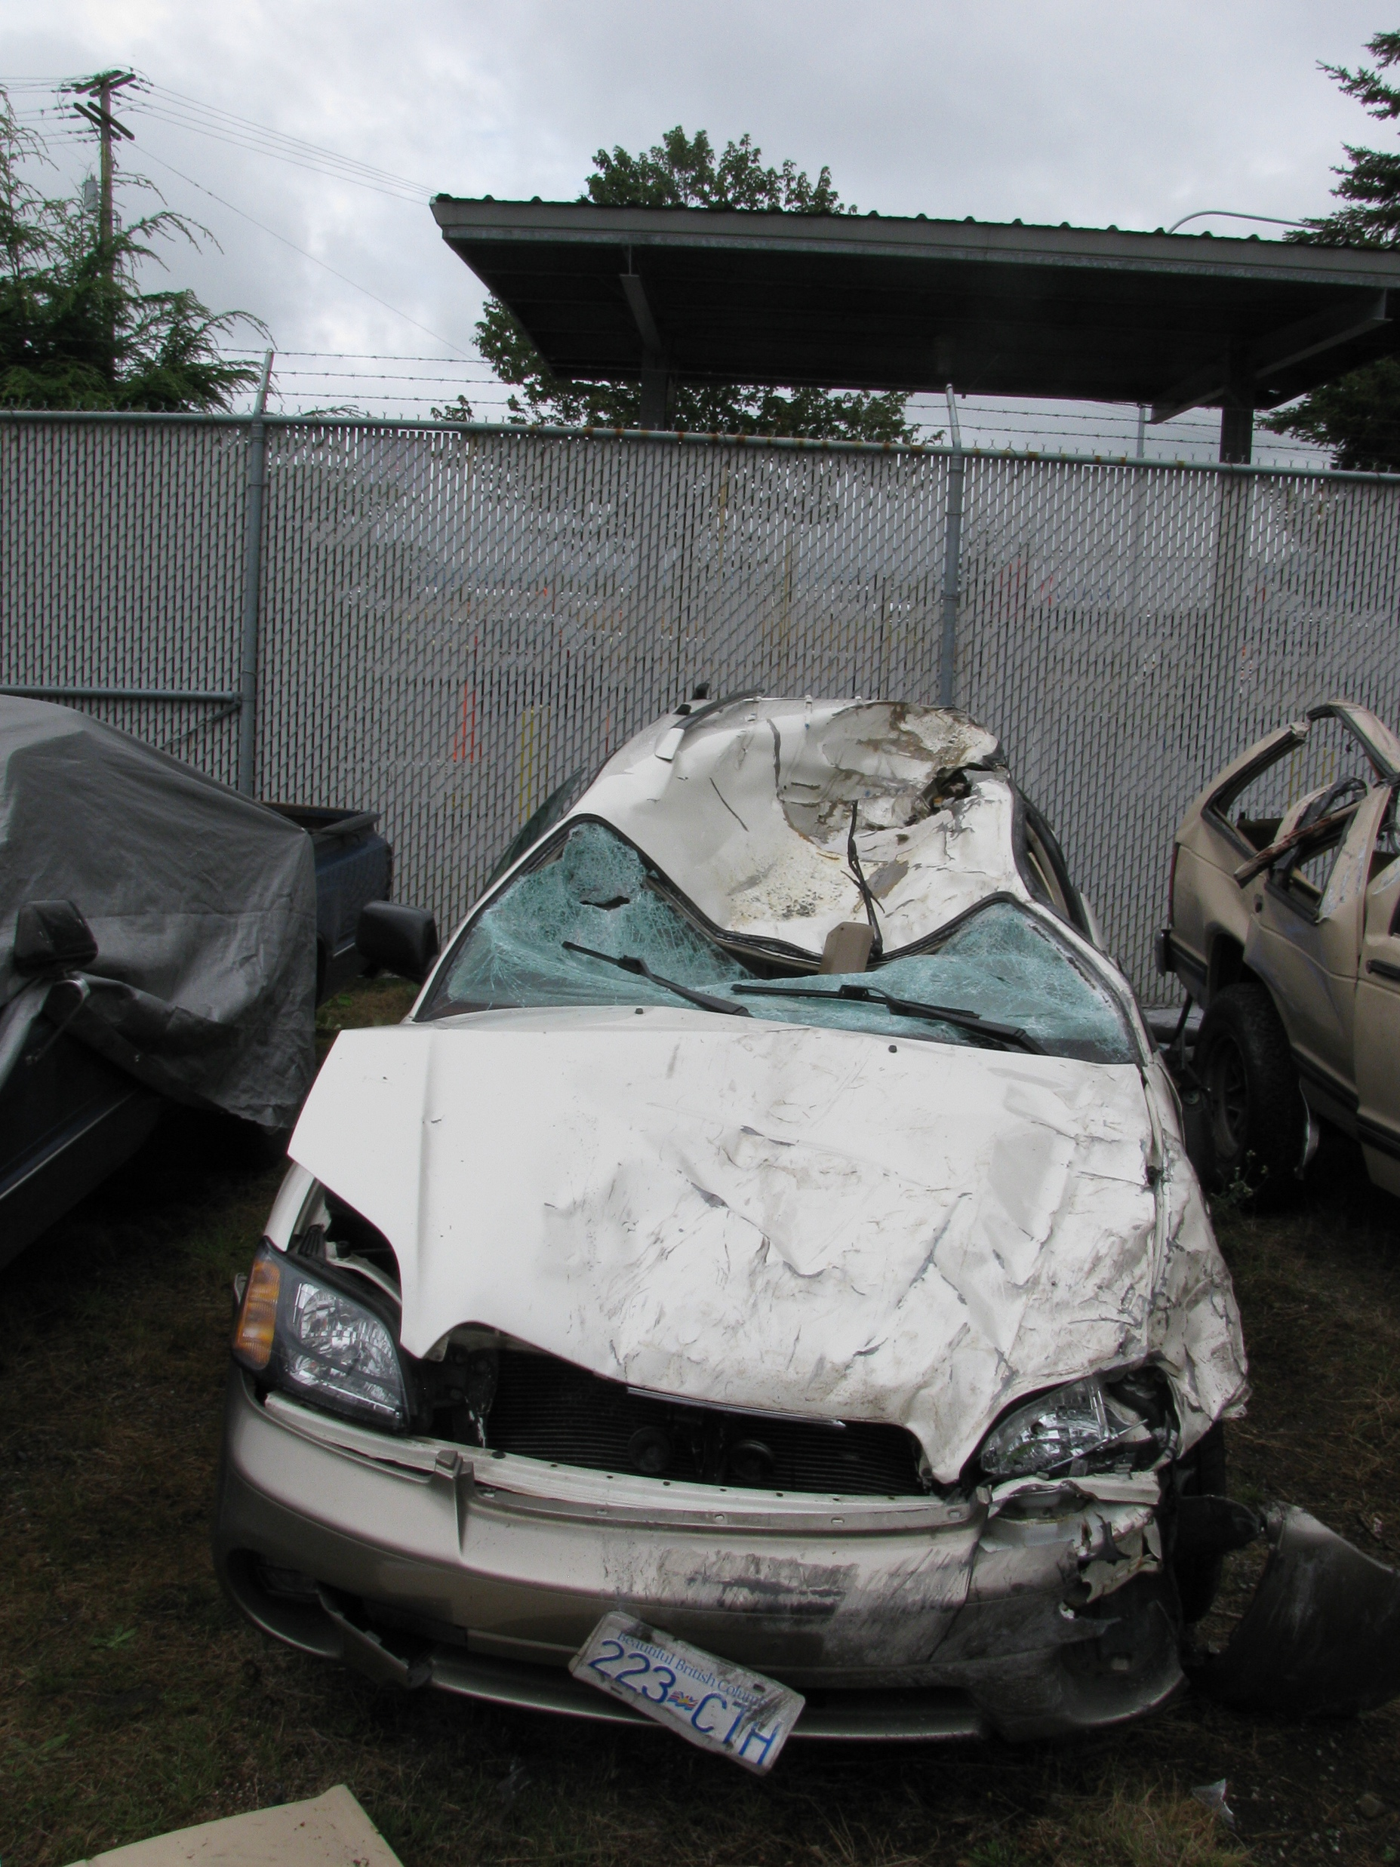
Notes:
The SUV was upside down and airborne when it went through Brian’s windshield, killing him instantly. Erin was injured and her neurologists tell her she will likely never fully recover. Seven weeks later, Erin gave birth to Sierra Grace. Brian never knew that he was the father of a baby girl that he wanted so badly.

Slide 4

Notes:
His friends created a fund to benefit Erin and their unborn baby. 5,000 people from around the world contributed to that fund. My wife Janice and I were overwhelmed with the expressions of support from family, Brian’s friends, and especially the video game world. Brian’s alma mater, Lawrence University, gave Sierra a four-year tuition-free scholarship to Lawrence, should she be accepted.

Slide 5
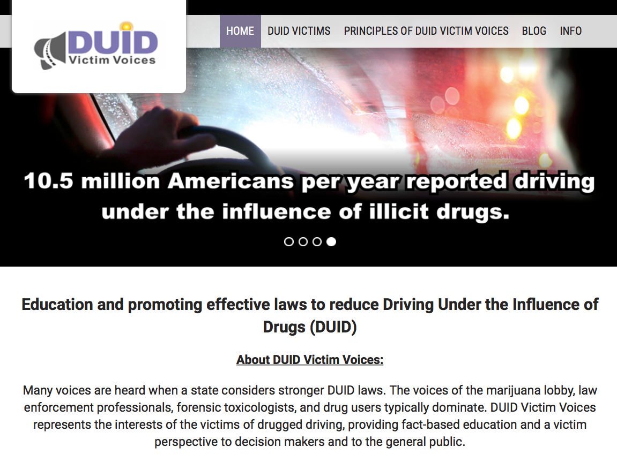
Notes:
The SUV was driven by Jordan Weichert (19) and Samantha Bowling (20). Yup. Two women were at the wheel at the same time. Weichert wanted to change her sweater while she was driving so she turned the steering wheel over to Bowling while they both drove. Bowling was on marijuana and methamphetamine. Weichert was on marijuana, methamphetamine and heroin. Both women were charged with vehicular homicide due to driving under the influence.
But they weren’t convicted of that. Both women were convicted of vehicular homicide due to driving with disregard for the safety of others, not DUI. That conviction earned them reduced sentences that have now been completed.
I learned that laws designed to provide some semblance of justice to victims of alcohol-impaired driving just don’t work well for victims of drug-impaired driving. At least not in the state of Washington. After the trial I learned the same or even worse, was true in Colorado.
++++++++++
So I created DUID Victim Voices to educate and promote effective laws to reduce DUID. We represent the interests of the victims of drugged driving, providing fact-based education and a victim perspective to decision makers and to the general public.
.

Slide 6
Myths
Colorado’s DUID problem is all about marijuana
A 5 ng/ml THC limit is effective in reducing DUID
90% of DUIDs result in DUI convictions
Drugs, including marijuana don’t impair driving
  NHTSA proved no link between crashes and marijuana
  DUID hasn’t increased in legal marijuana states
  I drive safer and slower under marijuana’s influence
None of the above are true.
Notes:
Let’s take a look at some of the myths about drugged driving that we need to dispel before we go on. First of all, drugged driving is not just about marijuana. I will present data that I hope will convince you that focusing only on marijuana impairment is counterproductive. Yes, marijuana-impaired driving kills and injures people. But deaths and injuries from drivers impaired by marijuana alone is only the tip of the iceberg. Polydrug impairment, which is impairment by two or more drugs simultaneously, is far more dangerous than impairment by marijuana alone.
A second myth is unique to Colorado. I’ll cover this in more detail shortly, and you will learn that our 5 ng/ml THC limit is not effective in either reducing DUID or in providing justice to victims of DUID.
DUID conviction rates are lower than DUI alcohol conviction rates and many of those convictions are not for DUI, but for lesser crimes negotiated as part of a plea bargain.
Then there’s the wishful thinking put out by many people that says drugs, including marijuana don’t impair driving at all. All of these myths are false, as we will cover shortly.

Slide 7
Marijuana vs Alcohol Impairment – Selected Differences
Marijuana Alcohol
Attempted compensation
Caution in experimental settings
Can perform simple tasks, impaired higher level cognitive functions
Control loss
Inability to process changes
Divided attention deficit
Tracking/Lane position (SDLP)
Increased reaction time
Lower inhibitions
Faster driving
Decline in visual and auditory perception and processing functions
Courtesy of Marilyn Huestis
Notes:
Alcohol is unlike marijuana in many ways. Some symptoms of impairment are identical for alcohol and marijuana such weaving in the lane, but there are also some very major differences. Those under the influence of alcohol tend to drive too fast, whereas some under the influence of marijuana will attempt to compensate for their self-recognized impairment by driving more slowly.

Slide 8
Effects of Illicit Drugs
 | Type | Examples | Driving effects
1 | Cannabinoids | Marijuana BHO | Euphoria, slowed thinking, slowed reaction time, confusion
2 | Depressants | Barbiturates Benzodiazepines Methaqualone | Lowered inhibitions, impaired coordination and judgment, drowsiness
3 | Dissociative Anesthetics | Ketamine PCP | Impaired motor function, panic, aggression, violence
4 | Hallucinogens | LSD Mescaline | Altered states of perception
5 | Opioids | Heroin Morphine Oxycodone | Euphoria, drowsiness, confusion
6 | Stimulants | Amphetamine Cocaine MDMA Methamphetamine | Exhilaration, loss of coordination, delirium, panic, paranoia, aggressiveness, hallucinations, violence
Notes:
Here we can see that six different classes of impairing drugs cause different types of impairment. What’s not shown are the driving effects when these drugs are combined, as they often are.

Slide 9
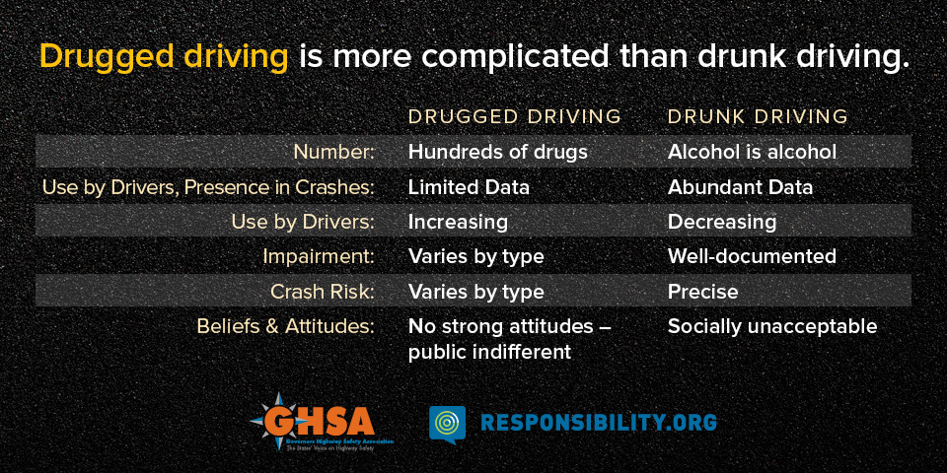
Notes:
Drugged driving is caused by hundreds of different drugs, not just marijuana, including all kinds of combinations of those drugs, plus drugs combined with alcohol. We have a great deal more data on alcohol-impairment than we do on drug impairment and we’ve used that data to drive down the incidence of alcohol-impaired driving while the incidence of drug-impaired driving is increasing. We have a long way to go to make drugged driving as socially unacceptable as drunk driving has become.

Slide 10
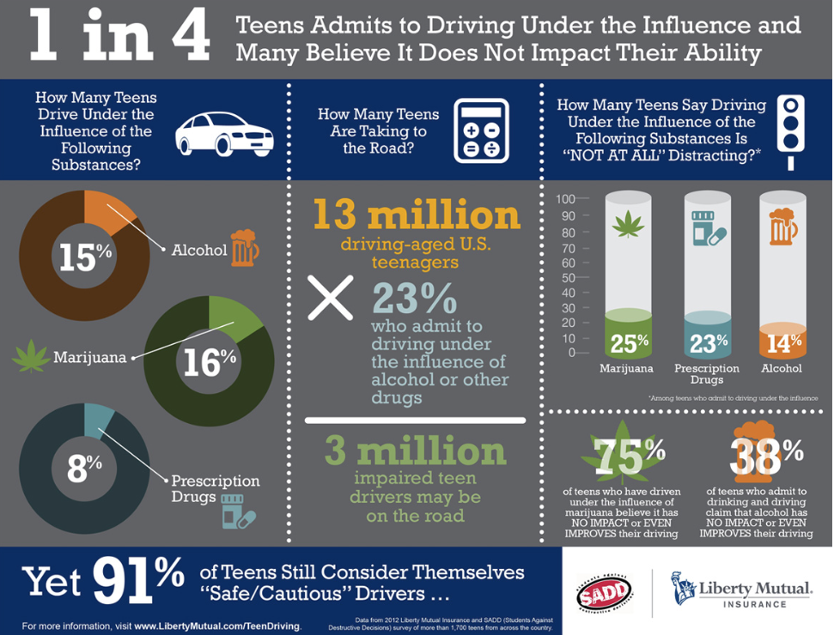
Notes:
Surveys tell us teenagers are woefully under-informed about the dangers of drugged driving. Of the 16% who have admitted to driving under the influence of marijuana, 75% believe that marijuana has either no impact or improves their driving skills! I hope that by the end of this discussion, you will be more informed than those responding to this survey.

Slide 11
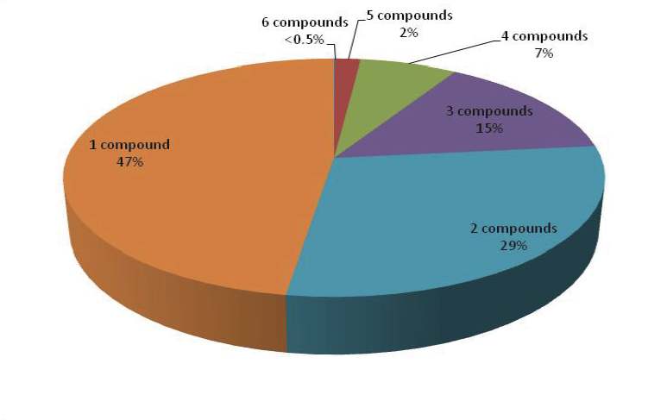
Polydrug impairment presence
3,616 samples from British impairment cases 2008-2012
Wolff K, Brimblecombe R, Forfar JC et al. Driving Under the Influence of Drugs. Feb 2013. ISBN 978-1-84864-139-6
Notes:
Now we're going to start getting into the data. I mentioned polydrug impairment earlier. This study of 5 years of data shows us how prevalent that really is. Less than half of the impairment cases in this study were impaired by a single drug.

Slide 12
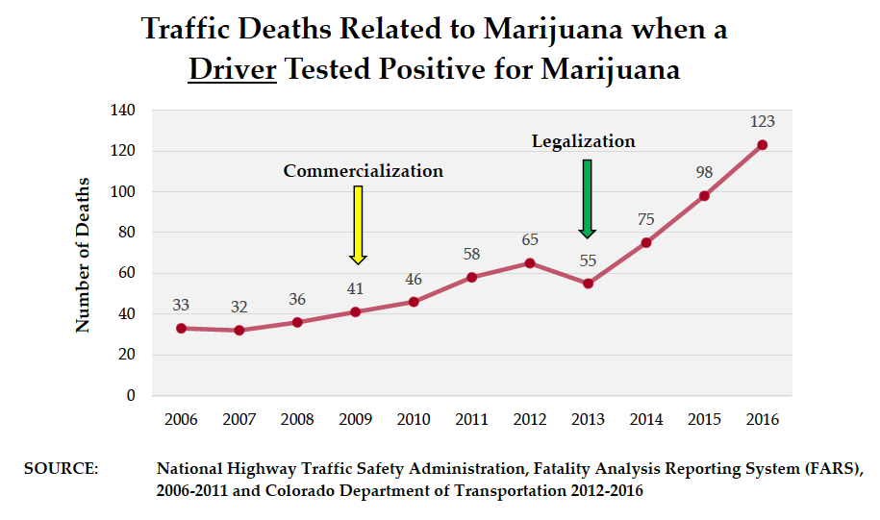
Gorman. The Legalization of Marijuana in Colorado: The Impact Vol 5 Oct 2017. Rocky Mountain High Intensity Drug Trafficking Area
Notes:
This shows traffic deaths related to marijuana when a driver tested positive for marijuana, based on reports developed in Colorado by the Department of Transportation, or, CDOT. It shows deaths increased significantly after marijuana legalization was passed in 2012 and went into effect in 2014. There was smaller rise after commercialization began in 2009/2010.
There are two things I want you to consider when you look at this graph. The first is that it shows the number of deaths, rather than the percentage of deaths and the second is that this is an 11 year graph starting in 2006.
Note also that this is based on FARS data, something I’ll talk more about in a moment. FARS stands for Fatality Analysis Reporting System, a project that is managed by NHTSA, the National Highway Traffic Safety Administration. You'll hear more about NHTSA later.

Slide 13
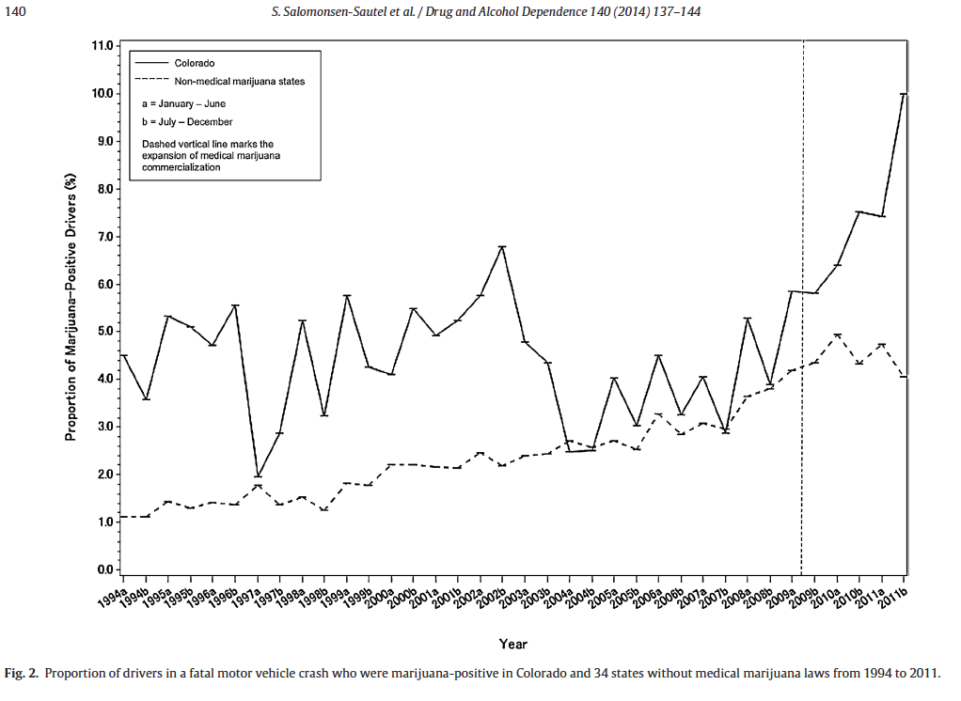
Notes:
Now look at data from the same FARS reports showing the percentage of deaths related to marijuana, rather than the total number. This is an 18 year graph starting in 1994. Same data, same source, just presented differently. This graph shows that the percentage varied around the 4% level from 1994 until commercialization in 2009, after which the percentage more than doubled. It tells a very different story, doesn’t it? Keep that in mind. The way data are presented can make a big difference in the message that is delivered.

Slide 14
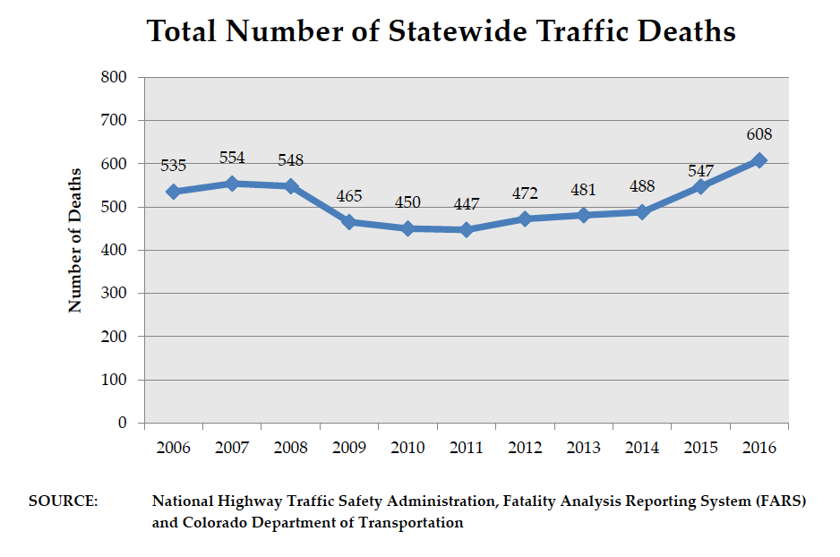
Gorman. The Legalization of Marijuana in Colorado: The Impact Vol 5 Oct 2017. Rocky Mountain High Intensity Drug Trafficking Area
Notes:
FARS also reports total statewide traffic deaths. The numbers for 2017 aren’t in yet but Glenn Davis of CDOT informed me that he expects the number will come out at about 640.
Although FARS does a great job for many of its reports, it was never designed to collect and analyze drugged driving information as well as it does for alcohol. FARS reports only the presence, not the concentration, of up to three drugs. This is a major reason people criticize FARS reports, saying that the presence of the drug does not necessarily mean that the driver was impaired. Most FARS data comes from coroners doing blood tests on people who were killed in car crashes. None of the dead drivers were issued citations for DUI, so we have no evidence in the report of whether or not they were impaired, other than the toxicology test.
It’s highly likely that the drivers were indeed impaired, but the information contained in FARS cannot prove that one way or another.

Slide 15
Types of evidence
Experimental
  Data collected on a small number of subjects, comparing them with suitable controls. All input variables are tightly controlled, all outcomes are measured and reported.
  Due to the expense of these studies, they can only include a limited number of subjects with a limited number of variables.
Epidemiologial
  Careful observations of a large number of subjects. The highest quality studies compare observations with control subjects.
  Because “all-comers” are included in the observations, input variables cannot be tightly controlled as they can be with experimental evidence.
Non-evidence
  Single observations, opinions, most “studies” done by TV reporters
Notes:
Before we get into some of the data showing how drugs impact safe driving, we need to understand the types of evidence we will consider, and that which we will not consider. We will look only at two types of evidence: experimental and epidemiological. Experimental evidence is based on data collected on a small number of subjects compared to controls. Often, the subjects will be their own controls by being tested both sober and when they are on drugs. Epidemiological evidence is based on observations of large populations, sometimes compared with controls. These studies cannot be as tightly controlled as experimental studies. Also, because highway driving is actually very safe, epidemiological studies are not valid unless they observe a very large number of subjects.

Slide 16
Do the math!
1.16/100,000,000
Alcohol 1/10,000,000
Statistically, driving is very safe. But we still had ~640 traffic deaths last year in Colorado
Notes:
How large? This will give you an idea. Nationwide, we have 1.16 deaths for every 100,000,000 vehicle miles driven. What does that mean? Well, if you were to drive an average of 20,000 miles per year in your car, which about normal, and do that from the time you get a license until you retire, you will drive only one million miles. So statistically, you would need 100 lifetimes before you would likely be involved in a fatal crash. So traffic fatalities are really pretty rare.
The risk of being in a fatal crash jumps significantly if you are drunk. On average, the Odds Ratio is about 8, which means that the average drunk driver is eight times more likely to be involved in a fatal crash than a sober driver. But that means a drunk driver would have a statistical chance of being in a fatal crash every 10,000,000 miles. Still pretty long odds, aren’t they? That’s one reason we still have a drunk driving problem. Too many people playing the odds. Earlier I mentioned that some people claim, based on FARS data, that there has been no increase in DUID in states with legalized marijuana. But because highway travel is generally so safe, you can see that total traffic deaths is a very blunt tool to measure the safety effect of marijuana, and most of those studies should be ignored.

Slide 17
Effects of marijuana
Cognitive effects
  Difficulty concentrating, sustained attention
  Fatigue, sleepiness, lethargy
  Memory problems
  Difficulty in thinking and problem solving
  Difficulty processing and using information
Psychomotor effects
  Decreased motor coordination
  Impairment in reaction time
  Impairment in tracking
Tests
  Lab tests: CTT, SST, TOL
  Road and simulator tests: SDLP, RT, TOL, HSD
Logan BK. Impact of Changing Marijuana Laws on Impaired Driving. NMS Labs. AAA Tampa conference 2015
Notes:
Psychometric tests can tell trained scientists how impaired a subject is. They look for both cognitive and psychomotor deficits. These are fairly difficult but important concepts that require highly trained psychologists to assess and interpret. They look for ability to concentrate, lethargy, memory deficits, and problem-solving ability. Psychomotor deficits include decreased motor coordination, impairment in reaction time and impairment in tracking, or staying in the traffic lane.

Slide 18
Marijuana, Alcohol and Actual Driving Performance
Dutch 2000 study, 18 subjects, actual driving, measured SDLP, TOL, RT, SDH
“Low doses of THC moderately impair driving performance when given alone but severely impair driving performance in combination with a low dose of alcohol [BAC .04-.05].”
THC dose | THC content of joint | Equivalent BAC
100𝛍g/kg | 2.2% | .09
200𝛍g/kg | 3.95% | .14
Ramaekers JG, Robbe HWJ, O'Hanlon. Marijuana, Alcohol and Actual Driving Performance. Human Psychopharmacology 15 551-558 (2000)
Notes:
Here’s an example of a highly regarded driving experiment. 18 subjects were used, who were either sober, given a low level of alcohol (BAC .01-.05, below Colorado’s DWAI limits), two different doses of smoked marijuana, or a combination of the two. The table shows results from subjects on both alcohol and marijuana. You can see that the subjects’ level of impairment was two or three times what one would expect with just alcohol alone. The study concluded that, “Low doses of THC moderately impair driving performance when given alone but severely impair driving performance in combination with a low dose of alcohol.”

Slide 19
Summary Experimental Evidence
Marijuana’s THC adversely affects:
  Reaction time
  Road tracking
  Sustained vigilance
  Neuromotor skills
  Decision making
Logan BK. Impact of Changing Marijuana Laws on Impaired Driving. NMS Labs. AAA Tampa conference 2015
Notes:
Since laboratory tests on a limited number of subjects can be well-designed and controlled, there is a good concurrence among scientists that marijuana’s THC causes measurable impairment. THC slows reaction time, causes lane weaving, lack of sustained attention and cripples the ability to deal with emergency situations. Even those well-educated in the marijuana lobby admit that these are valid observations. But where they depart is that the marijuana lobby says, “OK, these deficits can be measured, but are they sufficient to increase danger to motorists?” That’s where the epidemiological evidence becomes important.

Slide 20
Odds ratios: Marijuana, Alcohol, Both
Study | Marijuana | Alcohol | Both combined
Li 2017 (14,742+14,742) | 1.6 | 5.4 | 6.4
Chihuri 2017 ( 1,944+ 7,719) | 1.5 | 16.3 | 25.1
Laumon 2005 ( 6,766+ 3,006) | 1.8 | 8.0 | 16.0
Li studied 14,742 head-on crashes where both drivers were killed. The crash “initiator” was the study case and the “non-initiator” was the control.
Chihuri studied 1,944 drivers killed in 2006-2008, using drivers who participated in the 2007 National Roadside Survey for controls. Li participated in this study.
Laumon’s study was similar to Chihuri, performed in France.
Li G, Chihuri S, Brady J. Role of alcohol and marijuana use in the inietiation of fatal two-vehicle crashes. Annals of Epidemiology 27 (2017) 342-347
Chihuri S, Li G, Chen Q. Interaction of marijuana and alcohol on fatal motor vehicle crash risk: a case-control study. Injury Epidemiology (2017) 4:8
Laumon B, Gadegbeku B, Martin JL et al. Cannabis intoxication and fatal road crashes in France: population based case-control study. BMJ 2005 331, 1371
Notes:
Here are the summary results of three such well-respected epidemiological studies. Gouha Li studied 14,742 head-on crashes where both drivers were killed, where blood tests were available from both, and where evidence at the scene could determine which of the drivers initiated the crash. The initiator was the test subject, and the non-initiator was the control in this study. He found that the Odds Ratio for causing a fatal crash while being positive for THC was 1.6, for alcohol it was 5.4 and for the combination it was 6.4. These numbers are somewhat lower than what other investigators have found, perhaps because some of the non-initiators may have contributed to the crash. Recall that in our example earlier we used an assumption of an Odds Ratio of 8 for alcohol.
Stanford Chihuri studied 1,944 drivers killed between 2006-2008, but for controls, he used the survey results of drivers who volunteered to be tested but were not in a crash. The Odds Ratios for alcohol and the combination of THC and alcohol were much higher in this study than in Li’s study, perhaps because of the use of volunteer controls. By the way, Dr. Li participated in both studies, telling us both studies are equally valid, they just come up with different answers.
++++++++++++++++++++++++
Bernard Laumon’s earlier French study was similar to Chihuri’s, with results somewhere between those of Li and Chihuri.
You’ll notice that the Odds Ratio for drivers on THC is consistently much lower than the Odds Ratio for drivers on alcohol, which acknowledges that driving stoned is safer than driving drunk. But it’s still not safe. Moreover, when the two are combined, the Odds Ratio is about equal to the Odds Ratio of THC multiplied by the Odds Ratio of alcohol.

Slide 21
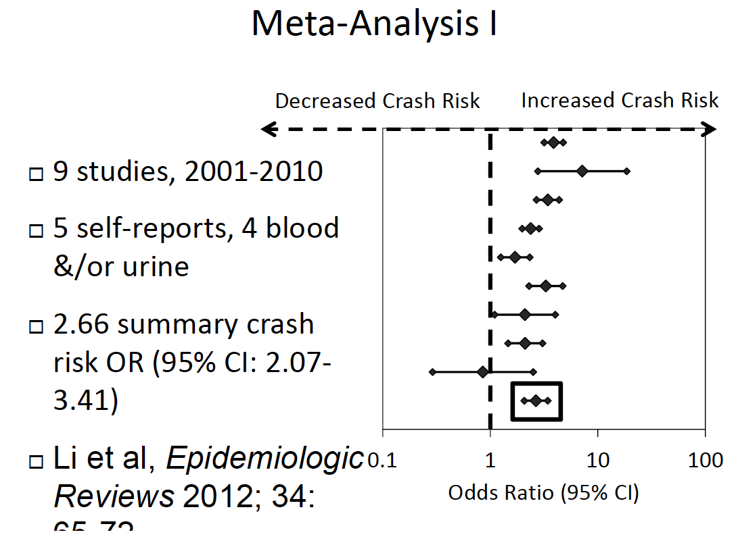
Li, M-C, Brady, JE, DiMaggio CJ et al. Marijuana Use and Motor Vehicle Crashes. Epidemiologic Reviews. 34:1 65-72 (2011)
Notes:
There have been literally thousands of epidemiological reports like the three I just showed you. Mu-Chen Li performed a meta-analysis on 2,960 such published reports. A meta-analysis is a way of pooling the results of several pieces of original research to arrive at an average conclusion. Li eliminated the secondary reports, selected those that reported Odds Ratios in a way that could be averaged with other reports, and then further reduced the list down to those of highest quality. Li’s team pooled the results, finding that the average Odds Ratio of a crash risk was 2.66 for THC.

Slide 22
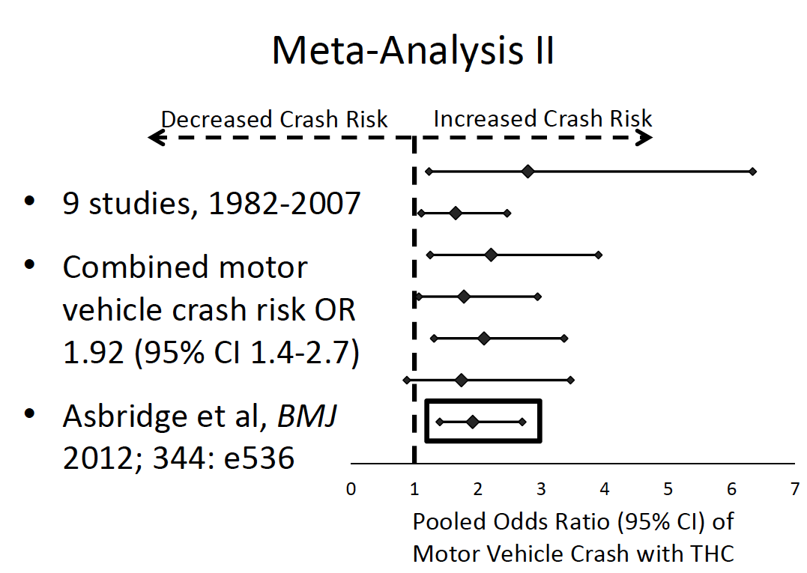
Asbridge M, Hayden JA, Cartwright JL. Acute cannabis consumption and motor vehicle collision risk: systematic review of observational studies and meta-analysis. Brit Med J 2012; 344:e536
Notes:
Mark Asbridge did a similar study a year later finding an Odds Ratio of 1.92 for a crash risk. Asbridge’s work has been more frequently quoted in the scientific literature than Li’s work. Asbridge used 19 data bases to locate studies covering 49,411 subjects.

Slide 23
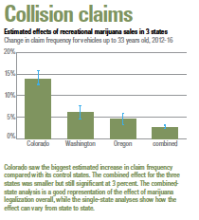
Stewart K. High claims. Insurance Institute for Highway Safety Vo 52 No 4 June 22, 2017
Notes:
A completely different, but equally valid epidemiological study was performed by the insurance industry that found insurance claims rose by an average of 3% after legalizing recreational marijuana in Colorado, Oregon and Washington, compared with non-legal states. Colorado’s increase was the highest at 14%. This will affect insurance rates for all of us.

Slide 24
Nat’l Academy of Science Conclusions
Conclusive or substantial evidence of the following:
Effective to treat adult chronic pain, chemotherapy anti-emetics, MS spasticity
Association with chronic bronchitis
Increased risk of motor vehicle crashes
Lower birth weight
Development of schizophrenia or other psychoses
Problem cannabis use risks
  Stimulant treatment of ADHD – NO
  Being male and smoking cigarettes – YES
  Initiating use at an early age – YES
  Frequent use - YES
The Health Effects of Cannabis and Cannabinoids: The Current State of Evidence and Recommendations for Research. Nat'l Academies of Sciences 2017
Notes:
All of this led the National Academy of Science to conclude that there is substantial evidence that marijuana increases the risk of motor vehicle crashes. Substantial evidence isn’t the same as conclusive evidence. That may become conclusive as further information is collected, published and digested.

Slide 25
Canadian Marijuana Impairment Costs
Canada records DUI charges by substances
”cannabis-attributable traffic collisions”:
  Caused 75 deaths
  Caused 4,407 injuries
  7,794 people involved in property damage crashes
  Total costs in 2012: CDN$1,094,972,062
Wettlaufer A, Florica R, Asbridge M et al. Estimating the harms and costs of cannabis-attributable collisions in the Canadian provinces. Drug and Alcohol Dependence 173 (2017) 185-9190
Notes:
The Canadians did a did a different kind of study to determine their costs of marijuana impairment. Canada can do this kind of study better than we can because they do a better job of measuring DUID and its effects than we do. They found that marijuana caused 75 deaths in 2012, and cost society over $1 billion Canadian dollars.

Slide 26
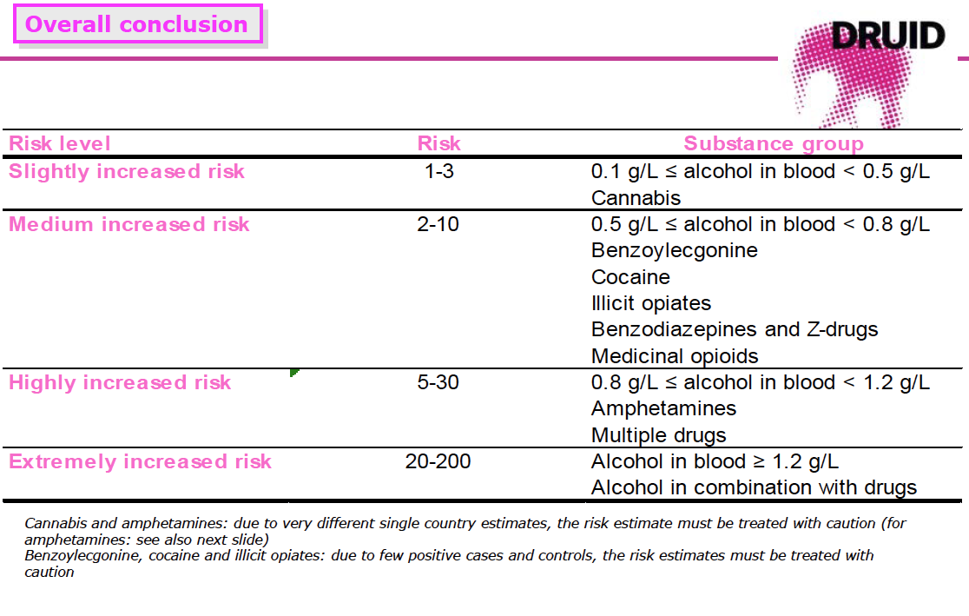
Hels T, Berhoft IM. Risk of serious injury and death for drivers positive for drugs. [Sound/Visual production (digital)]. DRUID Final conference, Cologne, Germany 27/09/2011
Notes:
The European Union performed a multi-year, multi-country study called DRUID – Driving Under the Influence of Drugs. They concluded that marijuana alone had a risk similar to low levels of alcohol, and they said both have a slightly increased risk. This is consistent with the studies I’ve just shown you. Other drugs had higher levels of risk, and the highest of all was high levels of alcohol or alcohol in combination with other drugs.
It’s important to keep a chart like this in mind to put all of what we’ve discussed so far in perspective. Marijuana-impaired driving kills and injures people, but marijuana alone is not as dangerous as other drugs, and especially combinations of drugs, including the popular combination of alcohol and marijuana.

Slide 27
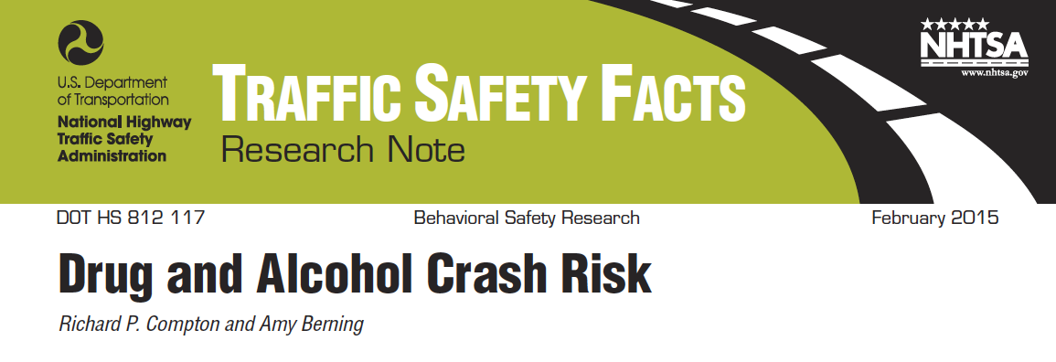
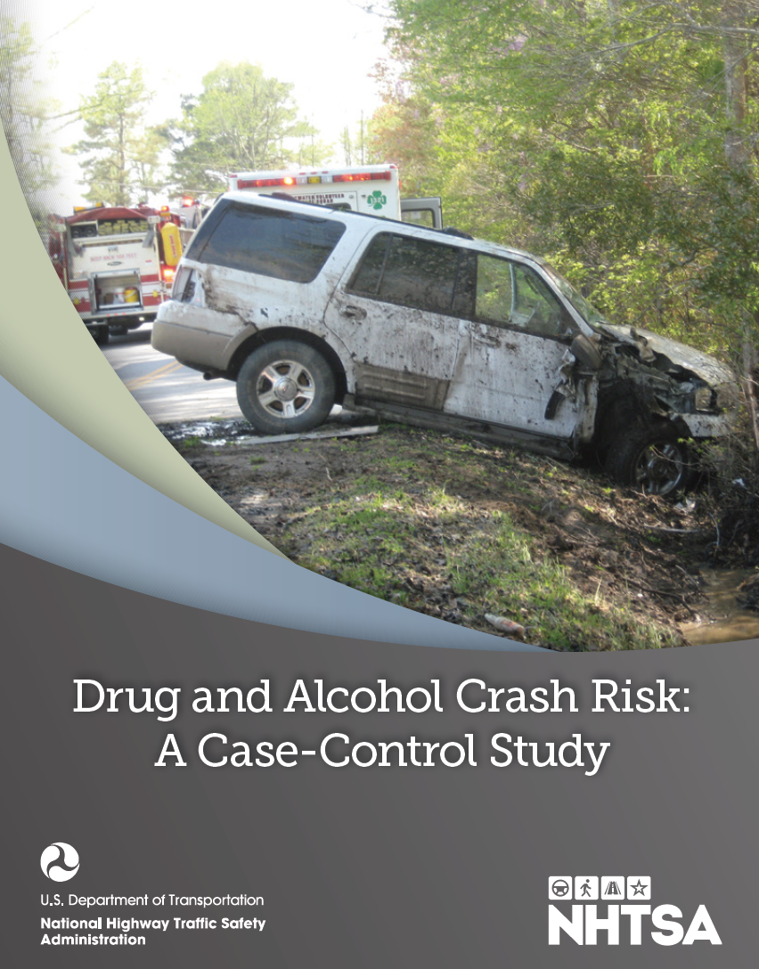
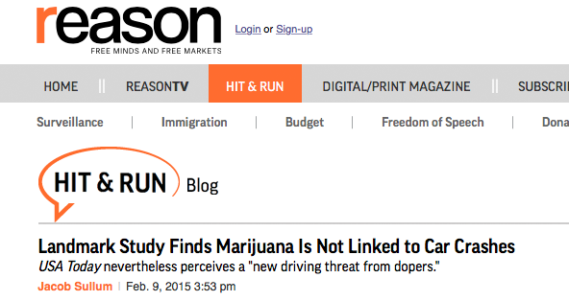
Contrary reports
Notes:
There are contrary reports, none of which have much credibility. Here’s an example of one that the marijuana lobby loves. February 2015, NHTSA released an 11 page summary of a study entitled Drug and Alcohol Crash Risk. The 177 page full study on Drug and Alcohol Crash Risk was released a year later
Three days after NHTSA 2015 announcement, the libertarian magazine Reason issued a Blog that I’ve highlighted in yellow, “Landmark Study Finds Marijuana Is Not Linked to Car Crashes.” Their interpretation of the study has been spread by the marijuana-friendly media everywhere, even such supposedly neutral outlets like FactCheck.org as recently as December.
There is no polite way to characterize this blog. It is a complete lie. Let’s look at the facts.

Slide 28
The facts:
Failure to find a link is not the same as finding there is no link.
The study failed to find a statistically significant link between any drug (except alcohol) and crashes – the study was flawed.
The study’s conclusion stated:
  “This study should not be interpreted to mean that it is safe for individuals who have used substances to operate a vehicle.”
Notes:
First of all, the study failed to find a link between crashes and marijuana use. A failure to find a link not the same thing as finding there is no link. Just like your failure to find your lost library book does not prove that the library book doesn’t exist.
Secondly, the study DID find a link between marijuana use and crashes. It found an Odds Ratio of a crash after using marijuana to be 1.25, similar to other studies I just showed you. But the study authors then adjusted the data to account for the fact that so many of the crash drivers were young who have a higher crash risk anyway. The adjusted crash risk then became insignificant. But the important point is that the study also failed to find a statistically significant link between crash risk and the use of any drug, cocaine, methamphetamines, opioids, or any combinations of those drugs, all of which are even more impairing than marijuana. They couldn’t find significant links simply because study was basically flawed for reasons we don’t have time to get into here. But look at the conclusion of the published study, “This study should not be interpreted to mean that it is safe for individuals who have used substances to operate a vehicle.” Yet that’s exactly what Reason magazine and most of the rest of the news media did back then, and many are still doing today.

Slide 29
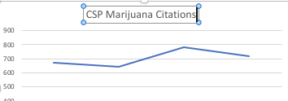
Political deception
Hickenlooper/Coffman claim:
  "In the first six months of 2017, the number of drivers the Colorado State Patrol considered impaired by marijuana dropped 21% compared to the first six months of 2016.”
But:
  Trend slightly up since start of data collection in 2014.
 | 2014 | 2015 | 2016 | 2017
Total marijuana citations | 674 | 641 | 780 | 719
Marijuana as % of total DUI/DUID citations | 14.6% | 13.4% | 16.9% | 14.8%
Notes:
Sometimes deception is created not by lying or manipulating data, but by cherry-picking and reporting only numbers that feel good. Here’s a classic example. Last August, Governor Hickenlooper, a Democrat, and State Attorney General Cynthia Coffman, a Republican, wrote a letter to the US Attorney General. They claimed that drugged driving was becoming less of a problem in Colorado, citing the fact that marijuana-impaired driving citations issued by the Colorado State Patrol dropped 21% from the first half of 2017 compared to the first half of 2016. They didn’t bother to mention the fact that those same citations increased by 22% from 2015 to 2016, and the long term trend is upwards. Both numbers are correct but they tell two different stories. Generally, long term trends are much more meaningful than short term trends, so when someone quotes short-term statistics to you to prove a point, you should be very wary. This may be why so many people are now accusing the Governor of covering up the facts about the problems marijuana commercialization is causing. He has recently denied this, but the facts prove otherwise. To be fair, he’s not the only one doing it and it's done by both Republicans and Democrats.

Slide 30
What about tolerance?
Frequent users claim they develop tolerance
  But not to all effects, else why continue using it?
  Different standards for addicts vs non-addicts?
Tolerance is misunderstood
  Daily users are chronically impaired so the degree of acute impairment from marijuana use is less than occasional users. But both end up similarly acutely impaired.¹
Individual responses to drugs vary widely
Cannabis and tolerance: acute drug impairment as a function of cannabis use history. Ramaekers et al. Nature. DOI: 10.1038/srep26843 (2016)
Notes:
So what about tolerance? You’ve probably heard the claim by marijuana users that they aren’t affected by marijuana because they’ve built up a tolerance to its effects. Well, tolerance is a reality for all drugs including marijuana and alcohol, but users can develop tolerance to only some of the effects of these drugs. After all, if they built up tolerance to all of the drugs’ effects, why would they keep using them? More importantly, tolerance is widely misunderstood. Chronic users have been shown to be chronically impaired at a low level. When chronic users smoke marijuana, they become acutely impaired like the occasional user does, but the increase in their impairment level is less than that of the occasional user, because chronic users start out somewhat impaired to begin with. What we don’t know is if their chronic impairment level makes them unsafe to drive.

Slide 31
Tolerance
It’s real
It’s over-rated
  Tolerance for only some effects of drugs
  Chronic marijuana users are still impaired
    Acute impairment
    Chronic impairment
Drug | Ratio between no-tolerance and high tolerance dosage
Alcohol | 1.5
THC | 4
Heroin | 10
Lachenmeier DW, Rehm J. Comparative risk assessment of alcohol, tobacco, cannabis and other illicit drugs using the margin of exposure approach. Scientific Reports 5:8126
  Ramaekers JG, van Wel JH, Spronk DB. Cannabis and tolerance: acute drug impairment as a function of cannabis use history. Scientific Reports Nature 6: 26843 (2016)
Bosker WM, Karschner EL, Lee D, Goodwin RS, Hirvonen J, et al. (2013) Psychomotor Function in Chronic Daily Cannabis Smokers during Sustained
Notes:
Impairment tolerance is a reality for all drugs, some more so than others. The ratio between no-tolerance and high tolerance dosage is low for alcohol, higher for THC, and extremely high for opioids like heroin.

Slide 32
Determining “Under the Influence”
  A. Driving pattern
  B. Impairment
    Visual
    Physiological
    Performance
C. Positive toxicology
    Ethanol
    Drugs
    - blood vs. urine
    - parent vs. metabolite
    - quantitation
⟩
These determine if someone is impaired
This determines what caused the impairment
Goldberger, BA, Stop Drugged Driving
Notes:
Most people think that a blood test proves impairment. But that’s not true at all. The only thing a blood alcohol level tells us is the blood alcohol level. Impairment is actually determined by driving behavior, impairment observations, and then supplemented by the lab results. The first two determine if someone is impaired, the lab data simply tells us what caused the impairment that was observed.

Slide 33
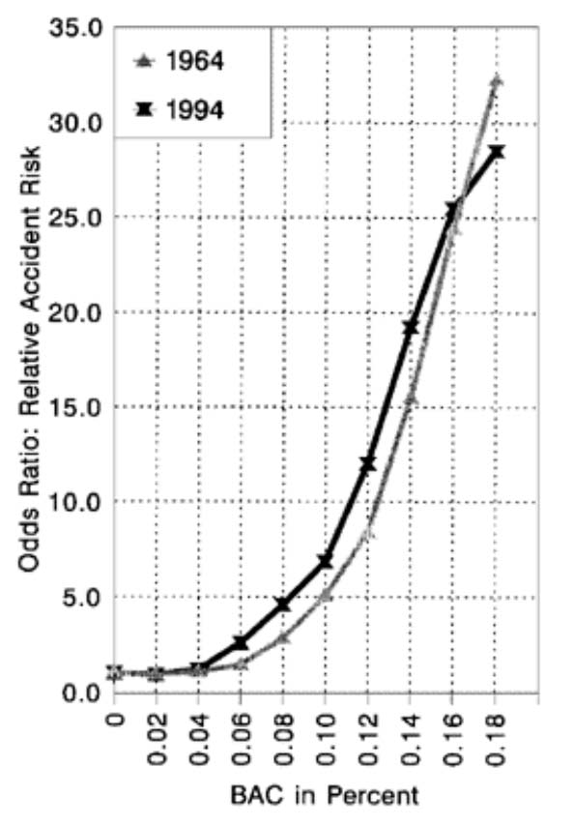
Science behind alcohol DUI per se
Kruger HP, Kazenwadel J, Vollrath M. Grand Rapids Effects Revisited: Accidents, Alcohol and Risk.
Notes:
There is a very strong relationship between blood alcohol level and the level of impairment. This was first shown in the 1960s with what has become known as the Borkenstein curve, one version of which is shown here. It has been reproduced many times in countries all over the world with similar results. The more alcohol in your blood, the more impaired you are.
But here’s the important point. Alcohol is the only drug for which a correlation between blood levels and levels of impairment has been shown. It has not been shown for heroin, methamphetamine, or any other drug. And for marijuana, it has been proven that such a relationship cannot exist. It’s not because we haven’t found that relationship yet. We have done the science, and we know for a fact that such a relationship does not and cannot exist. Let's look at why that is.

Slide 34
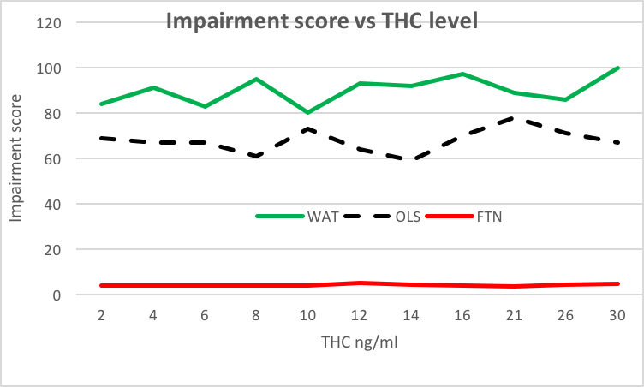
Blood THC levels vs. impairment scores
Declues K, Perez S, Figueroa A. A 2-year study of ∆99-tetrahydrocannbinol concentrations in drivers: examining driving and field sobriety test performance. J Forensic Sci Nov 2016 64:6
Notes:
Officers use Standardized Field Sobriety Tests to assess a driver’s level of impairment. SFSTs consist of three tests, Walk and turn, One leg stand, and an eye test called HGN. SFSTs have been very well validated for alcohol impairment, but are only modestly successful for drugs. Therefore we have some officers that receive extensive training as Drug Recognition Experts (DREs). They use a battery of 12 tests to assess a driver’s drug impairment. This slide shows the results of a two-year experiment of nearly 5,000 subjects arrested for drug impaired driving where they had blood THC test results available. The drivers were assessed for impairment by both regular officers as well as DRE-trained officers.
They found no relationship between the level of THC in blood and either Walk and Turn, One Leg Stand or Finger to Nose test results. Someone at 2 ng/ml could be just as impaired as someone at 30 ng/ml. A more rigorous study reported by the AAA Traffic Safety Foundation came to the same conclusion after looking at 16 different impairment tests.

Slide 35
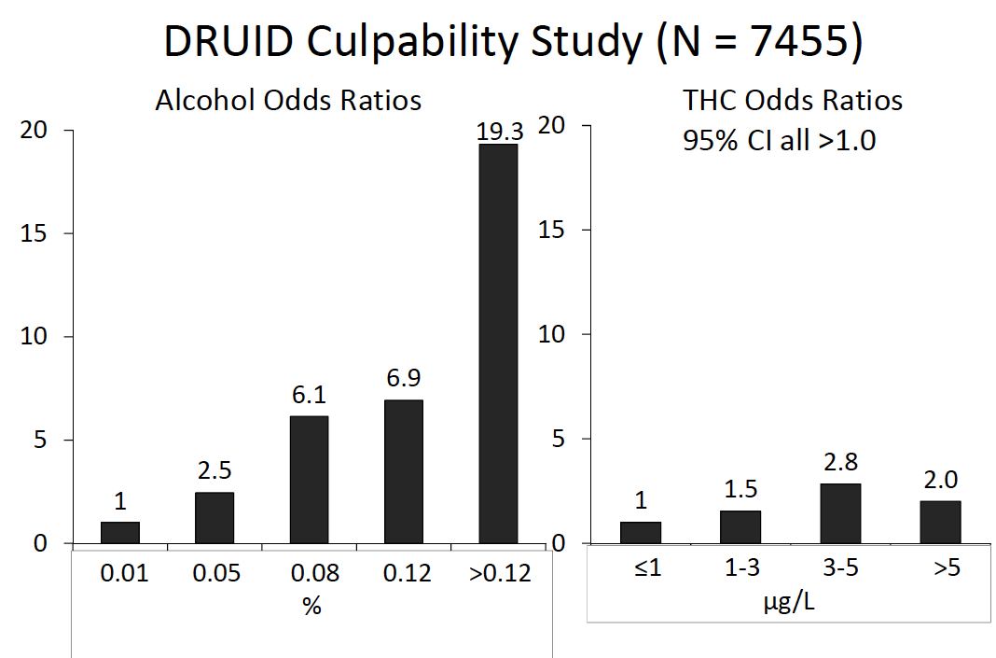
Huestis MA. Effects of cannabis with and without alcohol on driving. ACMT Seminars in Forensic Toxicology. Denver, CO, Dec 9, 2015
Notes:
The European DRUID study found the same thing in an epidemiological study of 7,455 drivers from five countries. There was a strong relationship between blood alcohol levels and death rates, but none between blood THC levels and death rates. A driver was as likely to kill an innocent victim with a low level of THC as with a high level.

Slide 36
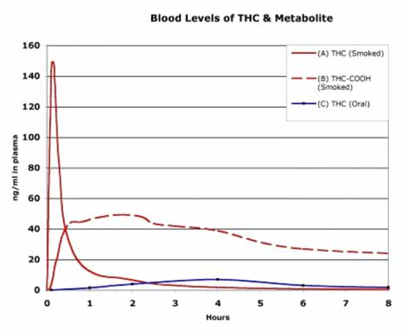
THC is rapidly removed from blood
Blood Cannabinoids. Huestis et al. J Anal Tox. Vol 16
Notes:
The reason for this is rooted in the sciences of chemistry and biology. We need to understand that blood is never impaired by THC, by alcohol, or by any other drug. Only the brain is impaired. The only way to measure drug levels in the brain is by an autopsy can’t be routinely done, so scientists looked for an alternative, or surrogate measure. For alcohol, blood is an excellent surrogate to determine what is in the brain. Alcohol is a small water soluble drug that rapidly establishes a concentration equilibrium between all highly perfused organs of the body, including the brain. So what’s in the brain is in the blood and vice versa. But that’s not true at all for THC. THC isn’t water soluble, it’s fat soluble and therefore insoluble in blood. So the brain and other fatty tissues quickly suck up any THC circulating in the blood. The maximum level of THC in blood drops an average of 73% within the first 25 minutes after starting to smoke a joint.
The THC is then metabolized by the body producing water-soluble carboxy THC which is an psycho-inactive metabolite. Carboxy THC then stays around in the body and in the blood for a long time, usually several weeks. That’s just not true for THC.

Slide 37
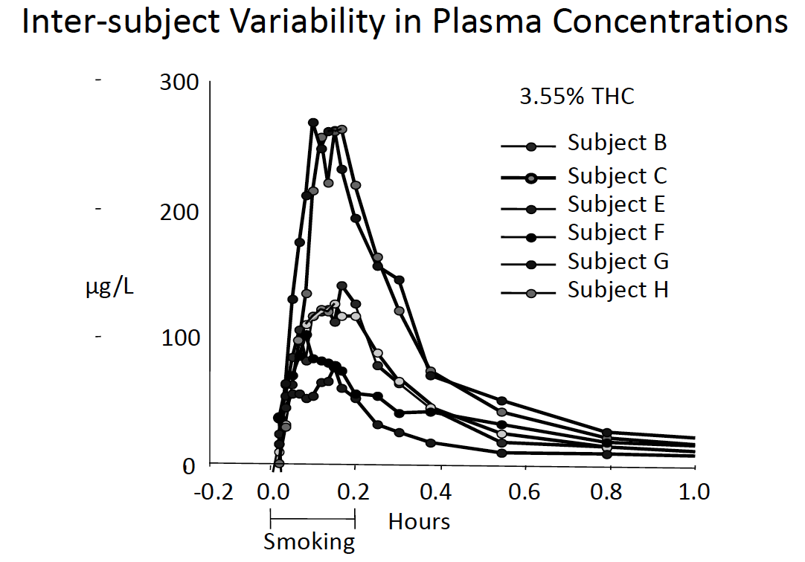
Huestis MA. Acute vs Chronic Frequent Cannabis Intake. ACMT Seminars in Forensic Toxicology. Denver, CO, Dec 9, 2015
Notes:
Of course, everyone doesn’t behave exactly like the graph I just showed you. Here we can see the variation in just six subjects. But all of them still have their blood levels drop to negligible levels in less than an hour.

Slide 38
Occasional vs frequent users
Comparison of Cannabinoid Pharmacokinetic Properties in Occasional and Heavy Users Smoking a Marijuana or Placebo Joint. Toennes et al. J. Anal Tox. Vol 32 Sept 2008
Notes:
It doesn’t matter if someone is a chronic user or not, the shape of the decay curve is the same. The chronic users start out at a higher level of THC in blood than the occasional user, but their level drops just as quickly.

Slide 39
How long to collect blood?
1 hr Routine DUIs – no warrant¹
2 hr DUI homicide and assault²
3 hr DUI homicide & assault-warrant²
Analysis of ∆⁹THC DUID Cases in Colorado. Urfer et al. J Anal Tox doi:10.1093/jat/bku089
Delays in DUI Blood Testing. Wood, et al. Traff Inj Prev. 17:2-105ff (2016)
Notes:
This is important, because it typically takes at least an hour after an arrest is made before blood can be drawn for a blood test, and the time is more like two or three hours when an officer is investigating a crash resulting in death or serious bodily injuries.

Slide 40
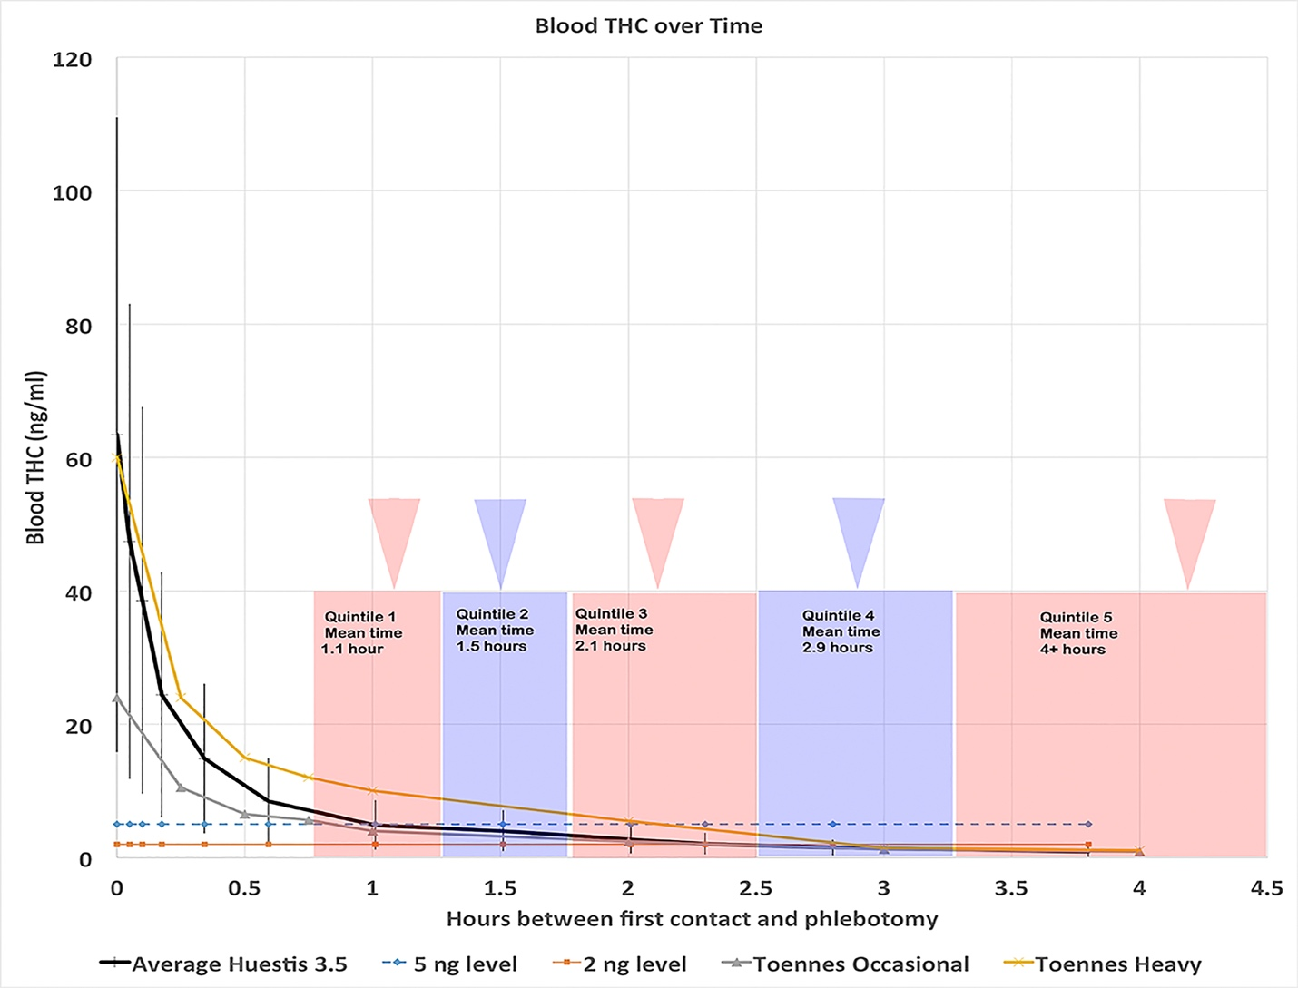
Delay Impact on Test Results
Wood E. Brief in opposition to C-46. Canadian House of Commons July 19, 2017
Notes:
This means that even in the extreme case where a driver was smoking marijuana at the time of a crash with had a very high blood THC level, most likely that level would test below Colorado’s 5 ng/ml permissible inference level except for chronic users, and they would just barely be above that level.

Slide 41
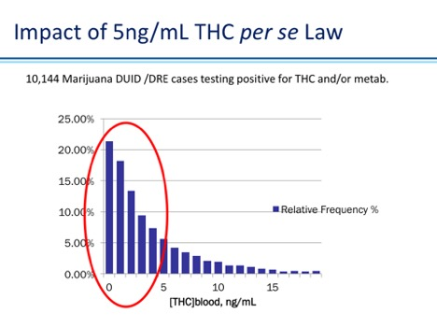
Most impaired drivers <5ng/ml
NMS
Notes:
This is why most drivers arrested on suspicion of driving under the influence of marijuana test below 5 ng/ml of THC in whole blood. This chart from NMS labs shows that over 70% of over 10,000 arrested drivers fall below 5 ng.

Slide 42
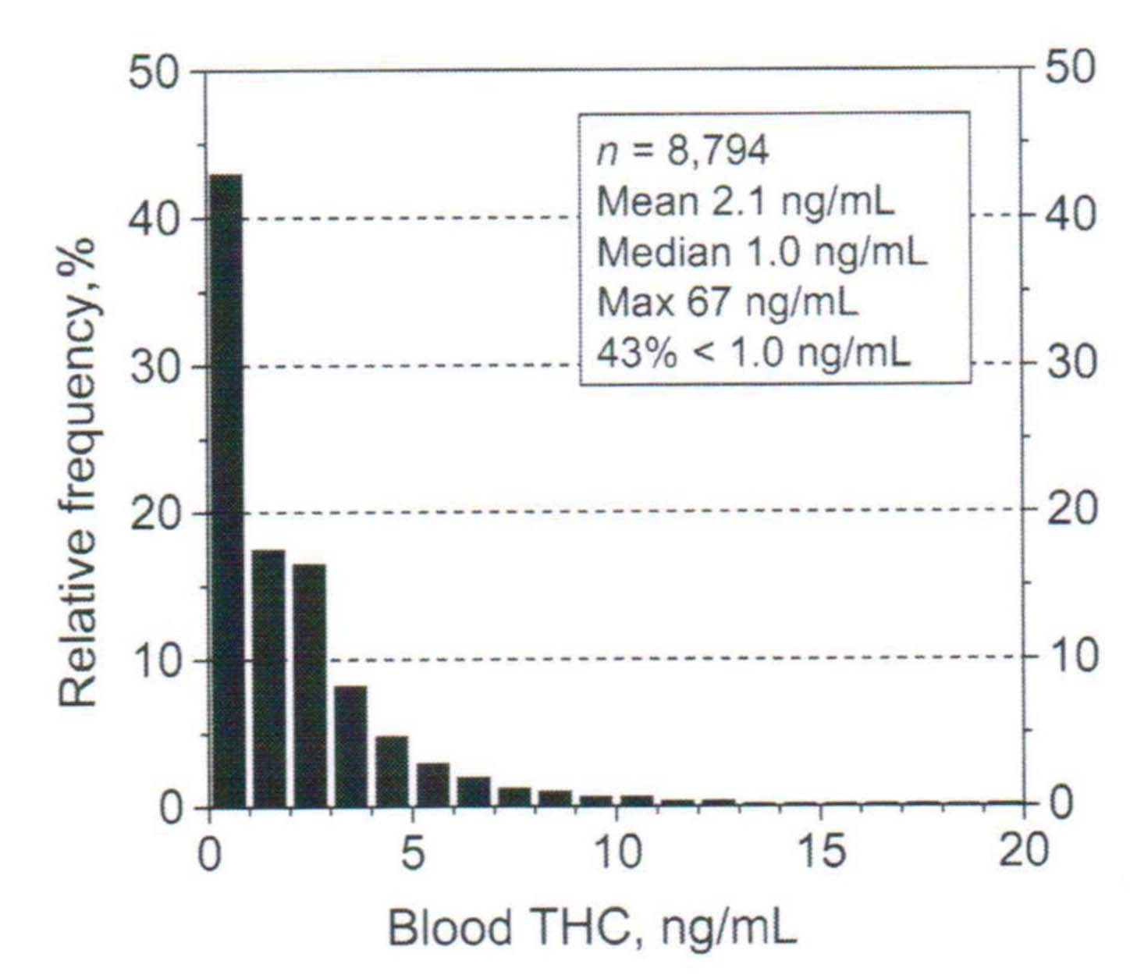
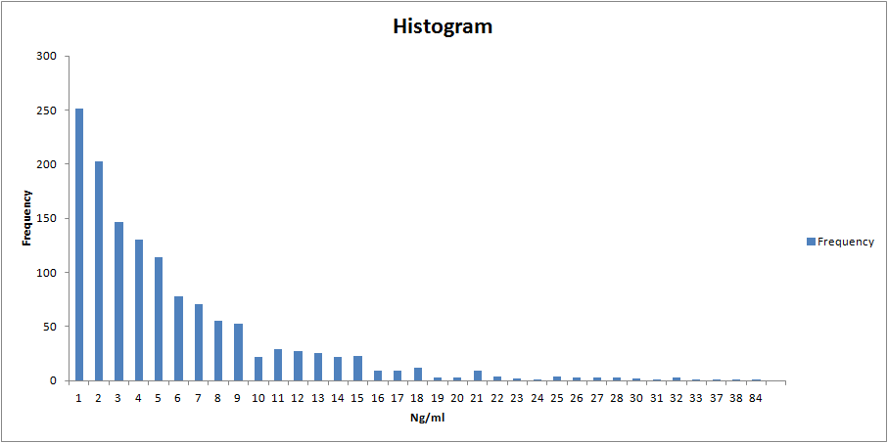
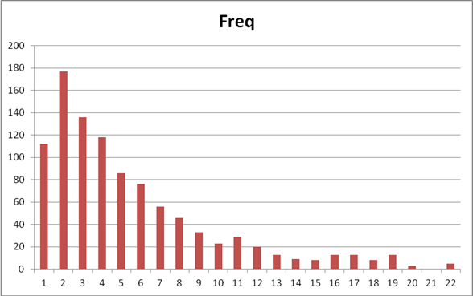
Forensic THC test results
Notes:
We see similar results from laboratories in Colorado, Washington and Europe. It’s not a matter of which lab does the testing, it’s a matter of chemistry and biology.

Slide 43
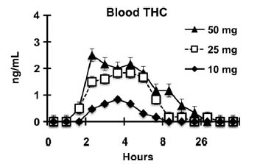
Marijuana edibles and blood THC levels
Vandry R, Herrmann ES, Mitchell JM. Pharmacokinetic profile of oral cannabis in humans: blood and oral fluid disposition and relation to pharmacodynamic outcomes. J Anal Tox 2017 41 83-99
Notes:
For marijuana edibles, it’s even worse. Since the THC from an edible is absorbed first in the gut and then slowly released to the blood, THC levels don’t even get above 3 ng/ml in blood and that's for someone taking five times the standard 10 mg dose.

Slide 44
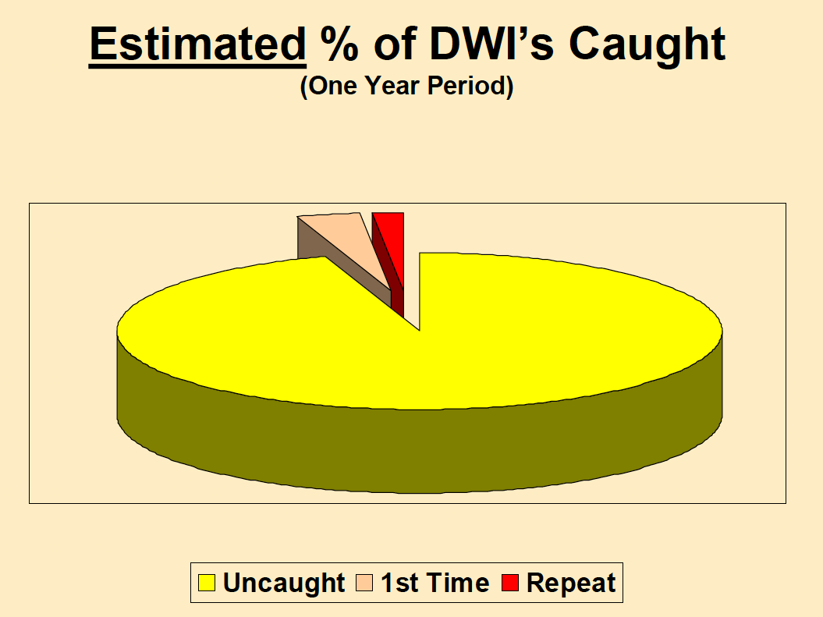
Fell JC. Enhancing Impaired Driving Enforcement. National Opinon Research Center (2016)
Notes:
Let’s move briefly to another matter. What are the chances of getting a DUI citation. Here the news is good for the driver. In spite of what you hear from CDOT, - Drive High, Get a DUI, your chances of being caught are really pretty low.

Slide 45
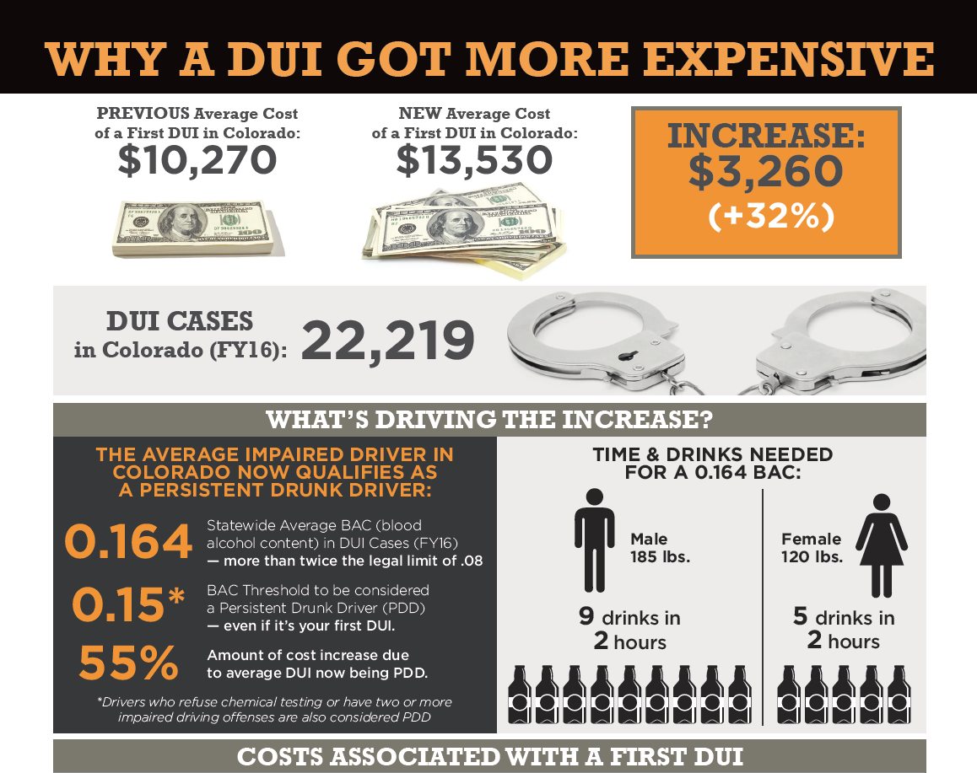
The Cost of the average first time DUI in Colorado. NoDUIColorado.org 2017
Notes:
But if you’re caught, be prepared to pony up. The latest data says the average cost for a first-time DUI has now risen to $13,530 in Colorado. The big cost items are legal costs, increased insurance costs, and the costs to get an alcohol ignition interlock device for your car. And yes, according to Colorado law, you will need an alcohol interlock device for your car even if you were convicted of DUI due to drugs and no alcohol was involved. That’s just the way the law works.

Slide 46
HB17-1315
DCJ-ORS annual DUI/DUID report
First report this year will cover 2016 data
Data to be obtained from:
    State judicial – DUI citations, court findings, sentences
      100% of citations
    CDPHE – evidentiary breath test data
      33% refusals, ~1/2 breath, ~ blood test at toxicology labs
    Toxicology labs (4) – drugs found and laboratory values
      most tested only for alcohol, no standard screen for drugs
    Probation services – pre-sentence evaluations
      100% of convictions only, inconsistent self-admissions and reports
Notes:
We’re getting to the end here, and by now you’ve seen that DUID is not all about marijuana, that it’s a serious yet badly misunderstood problem, that you’ve been lied to or misled by popular myths, and that Colorado’s laws don’t help us much. They are widely recognized as the weakest DUID laws in the nation. And those laws won’t change until legislators have concrete Colorado-based data to prove that they need to make changes. Last year we convinced the legislature to pass a DUID Data bill that will finally begin to get a handle on some of the badly needed DUID data by linking laboratory results with judicial outcomes so we can get some idea of the causes and consequences of DUID in our state.

Slide 47
Interim Legislative Study Committee
Summer, 2018
Per C.R.S. 2-3-303.3 – if Legislative Council OKs it
  3 Senators, 3 Representatives
  Task force to assist – LEA, prosecutors, judge, forensic toxicologist, medical toxicologist, addiction physician
Review following data
  Published reports and scientific papers since 2013
  DCJ’s report pursuant to HB17-1315
  Arrest information from CSP
Action – 5 bills to address the identified issues
Notes:
Subject to approval by the Legislative Council, there will be an interim legislative study committee held this summer to study some of the scientific evidence that I just showed you, as well as the results of the DUID Data bill which we expect shortly. We’re proposing that the committee be allowed 5 bills to be submitted to next year’s legislative session to begin to repair what needs repairing in our DUID laws.

Slide 48
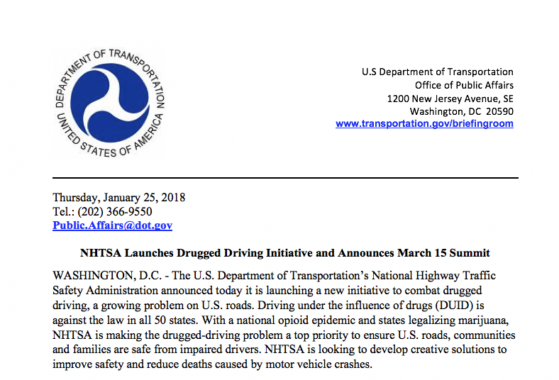
Notes:
Colorado is not alone in needing to address drugged driving. NHTSA just announced a DUID summit to be held next month. We’re working with them to configure and support that summit.

Slide 49

Notes:
We’re doing this work in memory of the many victims of DUID, including Tanya and Adrian Guevarra, killed by Steven Ryan whose blood level was found to be 4 ng/ml of THC. Fortunately this occurred before the legislature put in place the 5 ng permissible inference level, so Ryan was convicted and served a short time in prison – about three years of his ten year sentence.

Slide 50

Notes:
Steven Mager was killed by a marijuana-impaired driver. His parents subsequently convinced the legislature in Nevada where they live to impose a 2 ng THC per se limit in that state.

Slide 51

Notes:
And obviously, I do what I do in memory of our son Brian, killed by drug-impaired drivers.

Slide 52
References:
  Obtain a copy of this presentation at:
  http://www.duidvictimvoices.org/pueblo-west-hs/
  Learn more at:
    www.duidvictimvoices.org
    www.stopdruggeddriving.org
    www.stopduid.org
Notes:
Thank you for your attention. You may obtain a copy of these slides from the link shown here. I also invite you to continue your studies at the websites shown here.

Slide 53
Political deception
Hickenlooper/Coffman claim:
  "In the first six months of 2017, the number of drivers the Colorado State Patrol considered impaired by marijuana dropped 21% compared to the first six months of 2016.”
But:
  Trend slightly up since start of data collection in 2014.
 | 2014 | 2015 | 2016 | 2017
Total marijuana citations | 674 | 641 | 780 | 719
Marijuana as % of total DUI/DUID citations | 14.6% | 13.4% | 16.9% | 14.8%
2016 to 2017 Full year – 8% drop
2015 to 2016 Full year– 22% increase
Notes:
Sometimes deception is created not by lying or manipulating data, but by cherry-picking and reporting only numbers that feel good. Here’s a classic example. Last August, Governor Hickenlooper, a Democrat, and State Attorney General Cynthia Coffman, a Republican, wrote a letter to the US Attorney General. They claimed that drugged driving was becoming less of a problem in Colorado, citing the fact that marijuana-impaired driving citations issued by the Colorado State Patrol dropped 21% from the first half of 2016 to the first half of 2017. They didn’t bother to mention the fact that those same citations increased by 22% from 2015 to 2016. Both numbers are correct but they tell two different stories. Generally, as we have seen, long term trends are much more meaningful than short term trends, so when someone quotes short-term statistics to you to prove a point, you should be very wary. The annual drop was only 8%. Unfortunately, politicians of both parties have no incentive to admit that Colorado’s marijuana regulations aren't working well. Why admit failure? This may be why so many are now accusing the Governor of covering up the facts. He has recently denied this, but the facts say otherwise. To be fair, he’s not the only one doing it and it's done by both Republicans and Democrats.

Slide 54
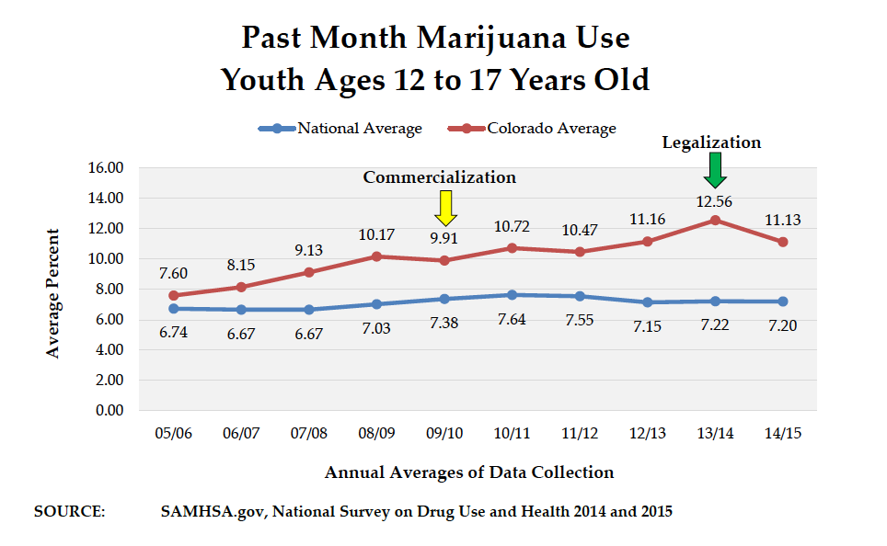
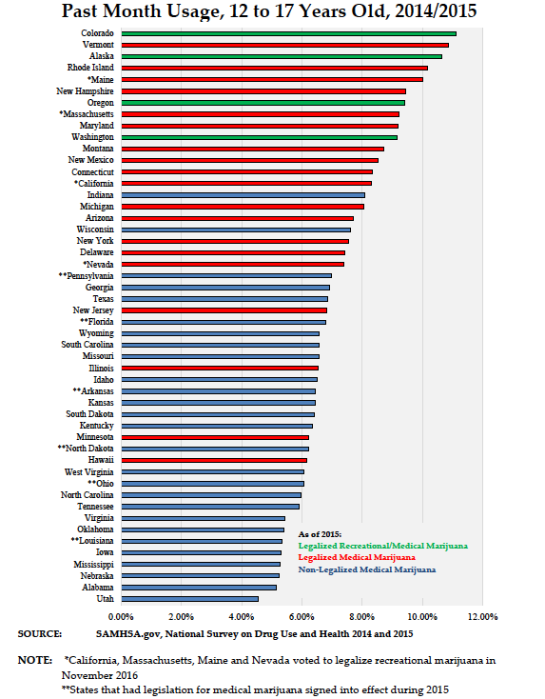
Hickenlooper vs the facts
The Governor*
The facts
HKCS omits 34% of state, & all school dropouts. HKCS has only qualified to be included in the CDC YRBS HS survey 4 times since 1991. The relevant comparison is post commercialization.
Colorado was #14 in 2005
HKCS: no significant change in youth use of marijuana since legalization. [HKCS is the only survey quoted by the Drug Policy Alliance.]
*Aug 24, 2017 letter to AG Sessions

Slide 55
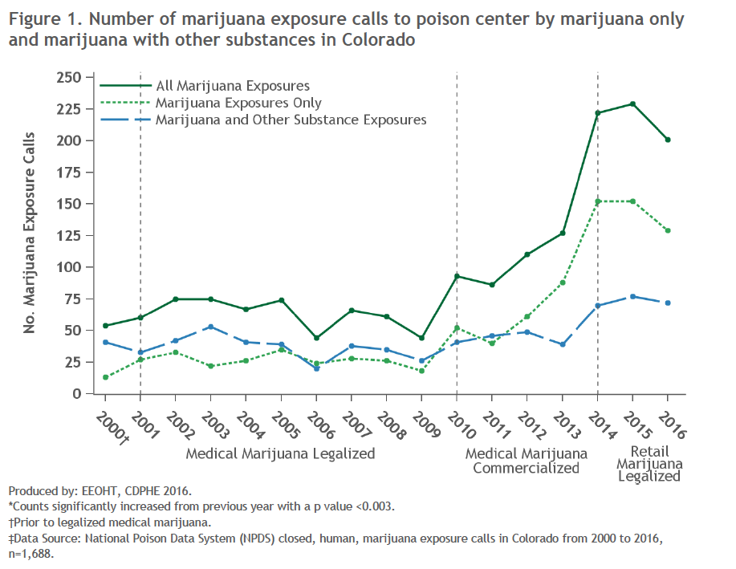
Hickenlooper vs the facts
The Governor*
The facts
Marijuana exposure calls [to the Rocky Mt. Poison and Drug Center] declined from 229 in 2015 to 201 in 2016, a 12% decrease.
Exposure calls up over 300% since commercialization (((229+201)/2)/70).
*Aug 24, 2017 letter to AG Sessions

Slide 56
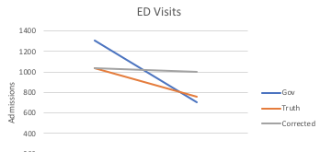
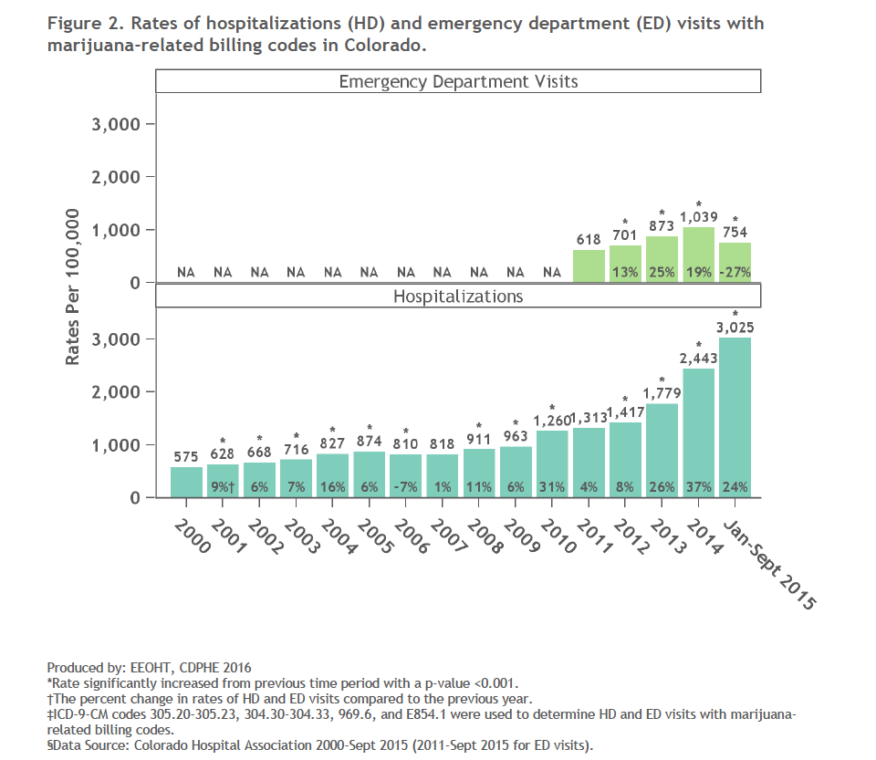
Hickenlooper vs the facts
The Governor*
The facts
MJ-related emergency department visits fell from 1,309 in 2014 to 704 in 2015.
MJ-related emergency department visits up 65% since 2011 (((1039+(4/3)*754)/2)/618)
MJ-related hospitalizations up 375% since commercialization (3025/800).
*Aug 24, 2017 letter to AG Sessions

Slide 57
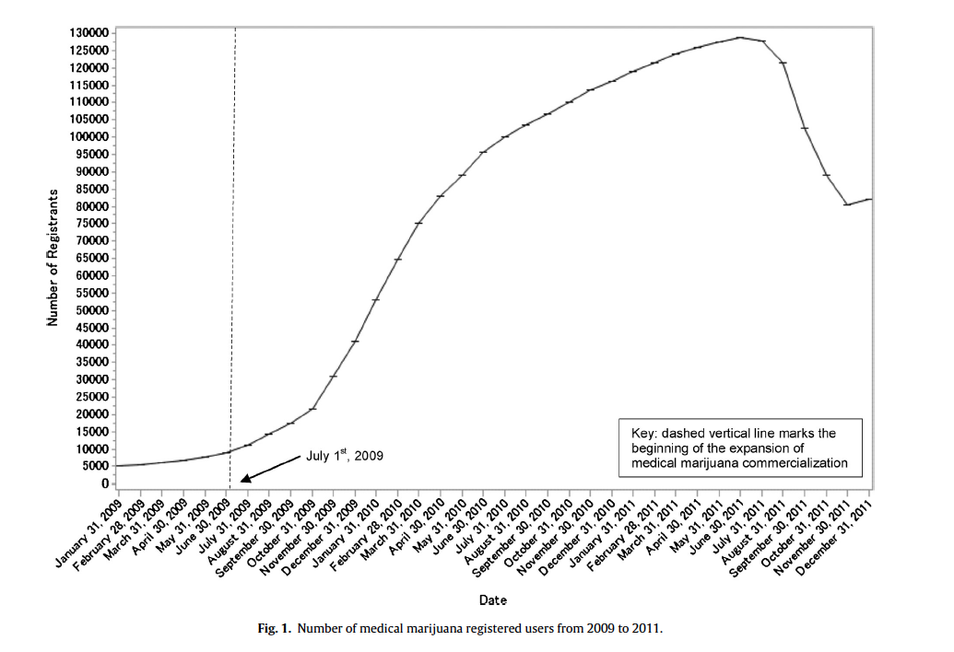
Salomonsen-Sautel S, Min S-J, Sakai JT et al. Trends in fatal motor vehicle crashes before and after marijuana commercialization in Colorado. Drug and Alcohol Dependence 140 (2014) 137-144

Slide 58
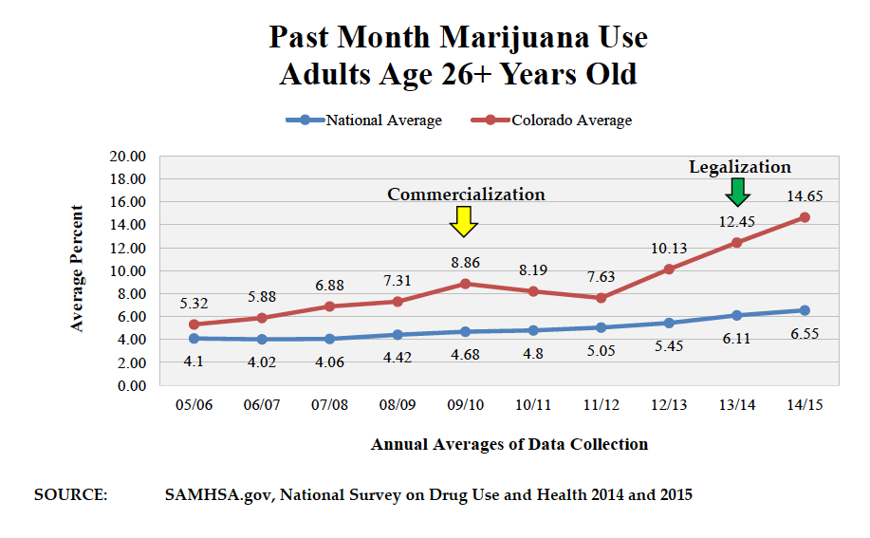
Hickenlooper vs the facts
The governor*
The facts
There has been no increase in overall consumption
*Micmedia Nov 22, 2017 video

Slide 59
Hickenlooper vs the facts
The governor*
The facts
Less drug dealers
Legal Dispensaries
Jan 2014 =156
Dec 2016 =459
[Colorado DOR]
Illegal seizures
2014 = 425 pounds
2016 = 3.5 tons
*Micmedia Nov 22, 2017 video

Slide 60
Hickenlooper vs the facts
The governor*
The facts
Less kids to prison
Marijuana arrests, 2012-2014
Overall -10%
Latinos +20%
Black +50%
[NPR Jun 29, 2016]
*Micmedia Nov 22, 2017 video

Slide 61
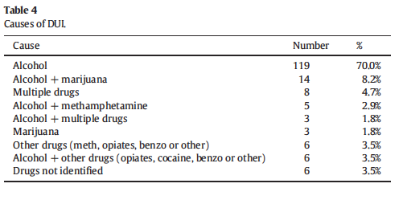
Wood E, Salomonsen-Sautel S. DUID prevalence in Colorado's DUI citations. J Safety Research 57 (2016) 33-38

Slide 62
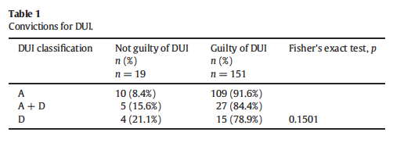
Wood E, Salomonsen-Sautel S. DUID prevalence in Colorado's DUI citations. J Safety Research 57 (2016) 33-38

Slide 63
What the Toxicologist cannot do….
Determine impairment in a specific individual from a blood concentration alone
Determine exactly how much drug was taken
Determine exactly when a drug was taken
Goldberger, BA, Stop Drugged Driving

Slide 64
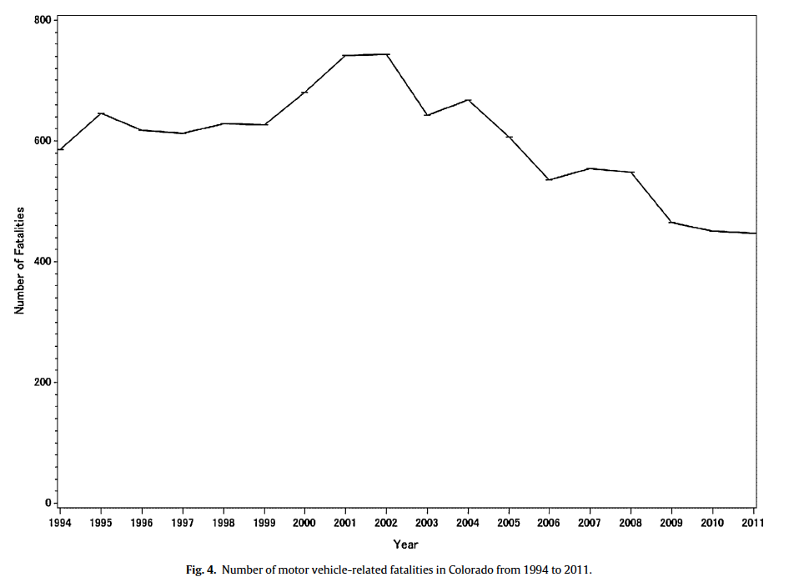
Salomonsen-Sautel S, Min S-J, Sakai JT et al. Trends in fatal motor vehicle crashes before and after marijuana commercialization in Colorado. Drug and Alcohol Dependence 140 (2014) 137-144

Slide 65
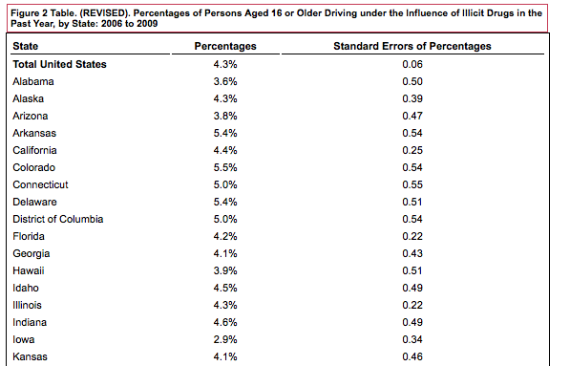
Self-admitted DUID Prevalence
States with higher rates than Colorado: MA, NT, NH, OR, RI, VT
National Survey on Drug Use and Health, 2006-2009

Slide 66
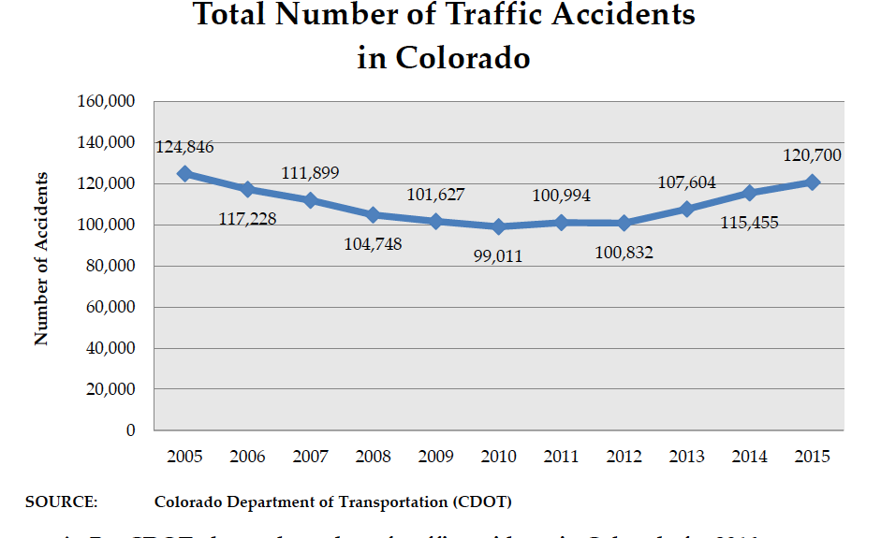
Gorman. The Legalization of Marijuana in Colorado: The Impact Vol 5 Oct 2017. Rocky Mountain High Intensity Drug Trafficking Area

Slide 67
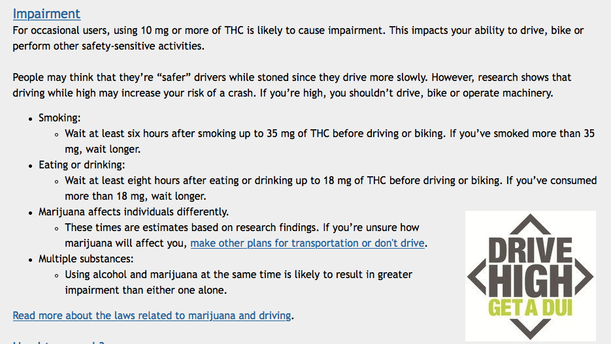
https://www.colorado.gov/pacific/marijuana/immediate-health-effects

Slide 68
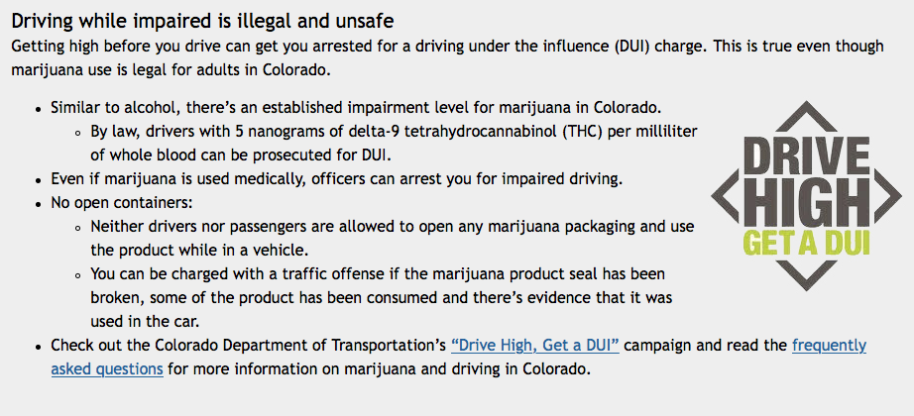
https://www.colorado.gov/pacific/marijuana/immediate-health-effects

Slide 69
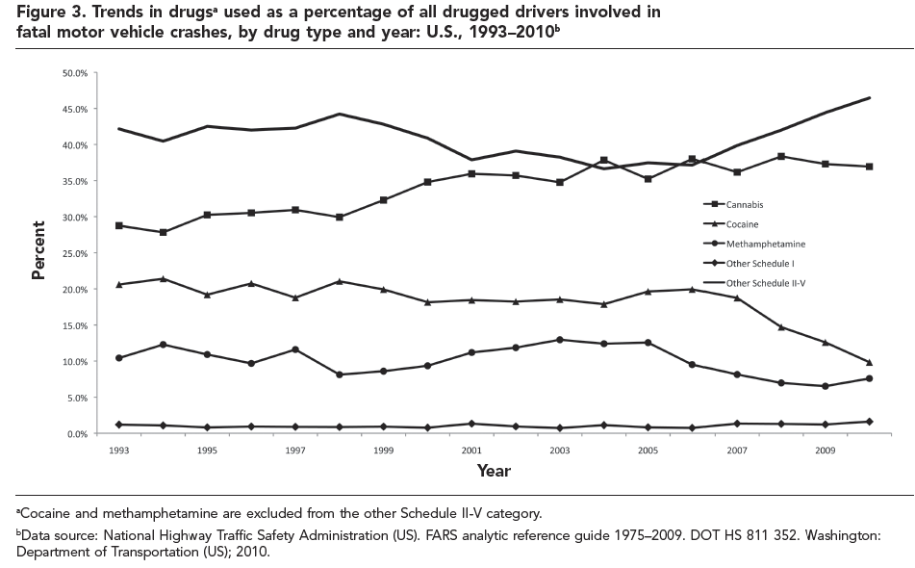

Slide 70
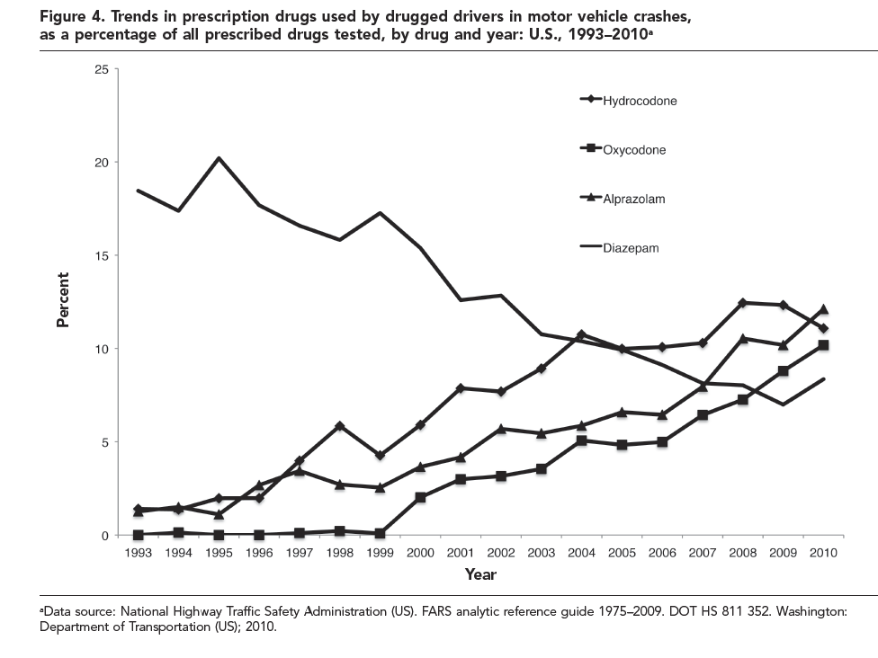

Slide 71
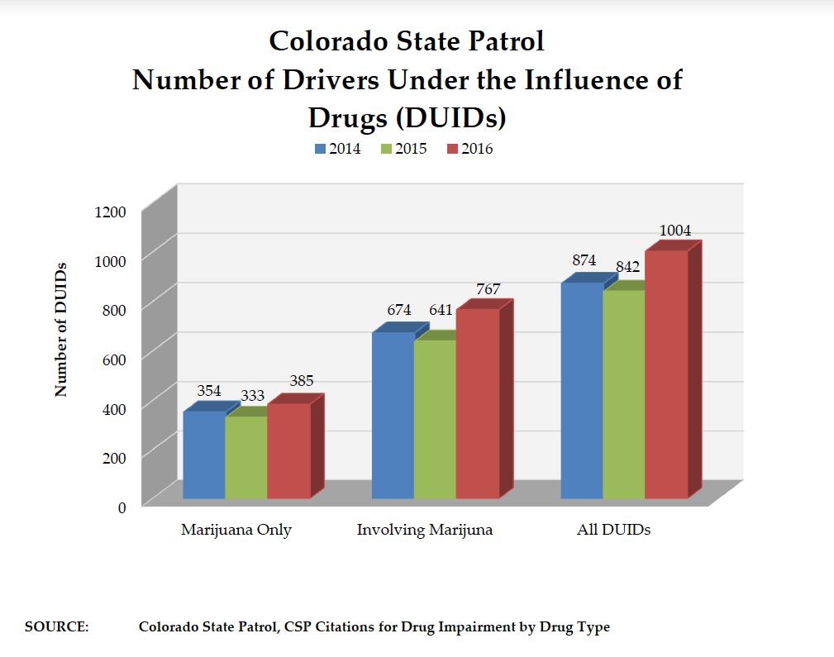
Gorman. The Legalization of Marijuana in Colorado: The Impact Vol 5 Oct 2017. Rocky Mountain High Intensity Drug Trafficking Area

Slide 72
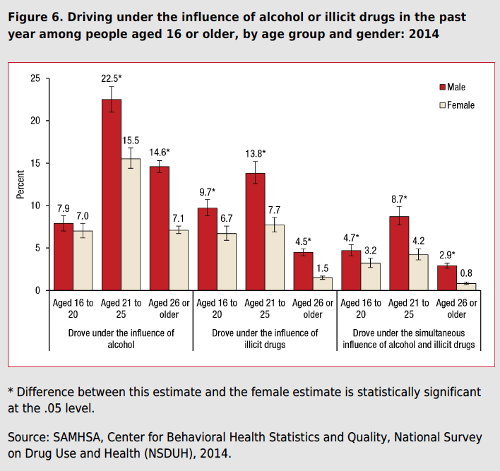

Slide 73
Drug Interpretation Issues
Multiple drug use
Tolerance
History of drug use (chronic vs. naïve)
Health
Metabolism
Genetic/ethnic differences
Individual sensitivity/response
Withdrawal
Put in context of case e.g. environmental factors
Goldberger, BA, Stop Drugged Driving

Slide 74
3 Ways to Prove Drugged Driving
The Hard Way. By Using a Statute like Florida’s. Requires proof of existence of a prohibited Drug and that the Drug caused impairment of normal faculties.
The Easier Way. By proving that the defendant had a certain level of a prohibited or controlled drug. (Per Se)
The Easiest Way By proving that the defendant had any detectable amount of a controlled drug. (Zero Tolerance)

Slide 75
Ten Drugs Most Often Identified
Goldberger, BA, Stop Drugged Driving

Slide 76
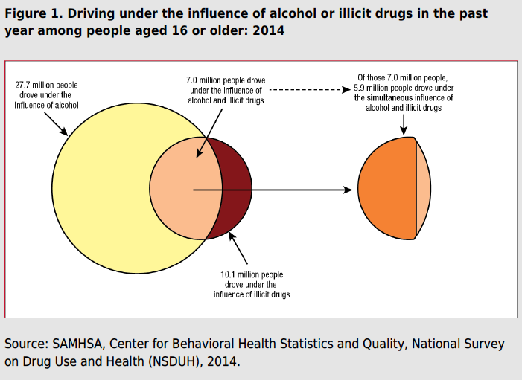

Slide 77
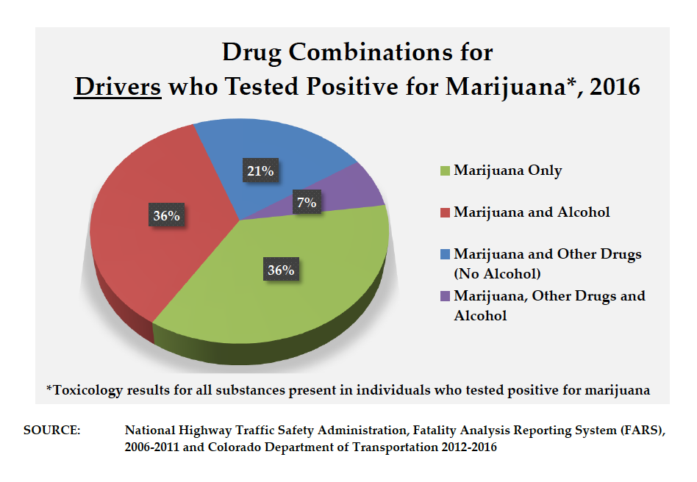
Gorman. The Legalization of Marijuana in Colorado: The Impact Vol 5 Oct 2017. Rocky Mountain High Intensity Drug Trafficking Area

Slide 78


Slide 79
Effects of Drugs on Driving
Coordination
Effects on nerves/muscles - steering, braking, accelerating, manipulation of vehicle
Reaction Time
Insufficient response - reaction
Judgment
Cognitive effects, risk reduction, avoidance of potential hazards, anticipation, risk-taking behavior, inattention, decreased fear, exhilaration, loss of control
Tracking
Staying in lane, maintaining distance
Attention
Divided, not focused. Time-shared task with high demand for info processing
Perception
90% of info processed while driving is visual. Glare resistance, recovery, dark and light adaptation, dynamic visual acuity
Goldberger, BA, Stop Drugged Driving

Slide 80
C.R.S. 42-4-1301
(1) (a) A person who drives a motor vehicle or vehicle under the influence of alcohol or one or more drugs, or a combination of both alcohol and one or more drugs, commits driving under the influence.
    (f) "Driving under the influence" means driving a motor vehicle or vehicle when a person has consumed alcohol or one or more drugs, or a combination of alcohol and one or more drugs, that affects the person to a degree that the person is substantially incapable, either mentally or physically, or both mentally and physically, to exercise clear judgment, sufficient physical control, or due care in the safe operation of a vehicle.
(2) (a) A person who drives a motor vehicle or vehicle when the person's BAC is 0.08 or more at the time of driving or within two hours after driving commits DUI per se.
(6) (a) In any prosecution for DUI or DWAI, the defendant's BAC or drug content at the time of the commission of the alleged offense or within a reasonable time thereafter gives rise to the following presumptions or inferences:
    (IV) If at such time the driver's blood contained five nanograms or more of delta 9-tetrahydrocannabinol per milliliter in whole blood, as shown by analysis of the defendant's blood, such fact gives rise to a permissible inference that the defendant was under the influence of one or more drugs.

